Slide 1
WP2
Biomarkers binding and quantitative analysis
Magnetic Nanoparticles
Synthesis & Characterization
AUTh

Slide 2
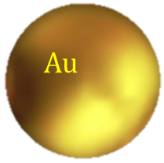
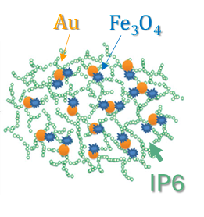
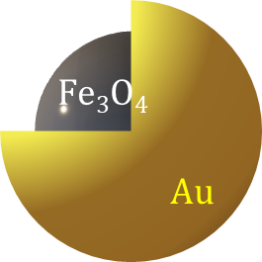
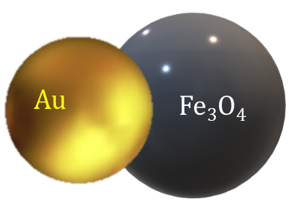
NPs overview
Sample Description | Code Name | Reference | Structure & Morphology |  | Hydrodynamic Properties (DLS) |  | Magnetic Properties (VSM@RT)
 |  |  | XRD | TEM (nm) | D_{H} (nm) | Zeta Potential (mV) | M_{s} (Am²kg⁻¹) | % M_{s} ³
Au Reference-1 | AuFe07 (Au-ref) | Dong et al. | ✓ | (17 ± 2¹) | 78 | -64 | - | -
Au Reference-2 | AuFe08 (GMCP4- Au Part) | Ochea et al. | ✓ | (18 ± 3¹) | 31 | 0 | - | -
Au-decorated MNPs | AuFe01 (GMCP1) | Miyazaki et al. | ✓ | 10 ± 5 (10 ± 2¹) | 1120 | -49 | 39 | 43
Core-Shell-1 | AuFe05 (GMCP2) | Hongjian, et al. | ✓ | 12@3 (15 ± 2¹) | 76 | -77 | 32 | 36
Core-Shell-2 | AuFe11 (GMCP3) | Stein et al. | ✓ | 10-30@40-60 (15¹) | 160 (152²) | -70 (-49) | 24 (22) | 27 (24)
Core-Shell-3 | AuFe15 (GMCP4) | Ochea et al. | ✓ | (30 ± 9¹) | 120 | -60 | 8 | 9
Janus Particles | AuFe06 (DGM) | Garanina et al. | ✓ | (21@3¹) | 300 (251 ± 23²) | -50 | 5 | 6
1. TEM Reference 2. DLS Reference 3. Fe₃O₄ M_{s}= 91 A m² kg⁻¹

Slide 3
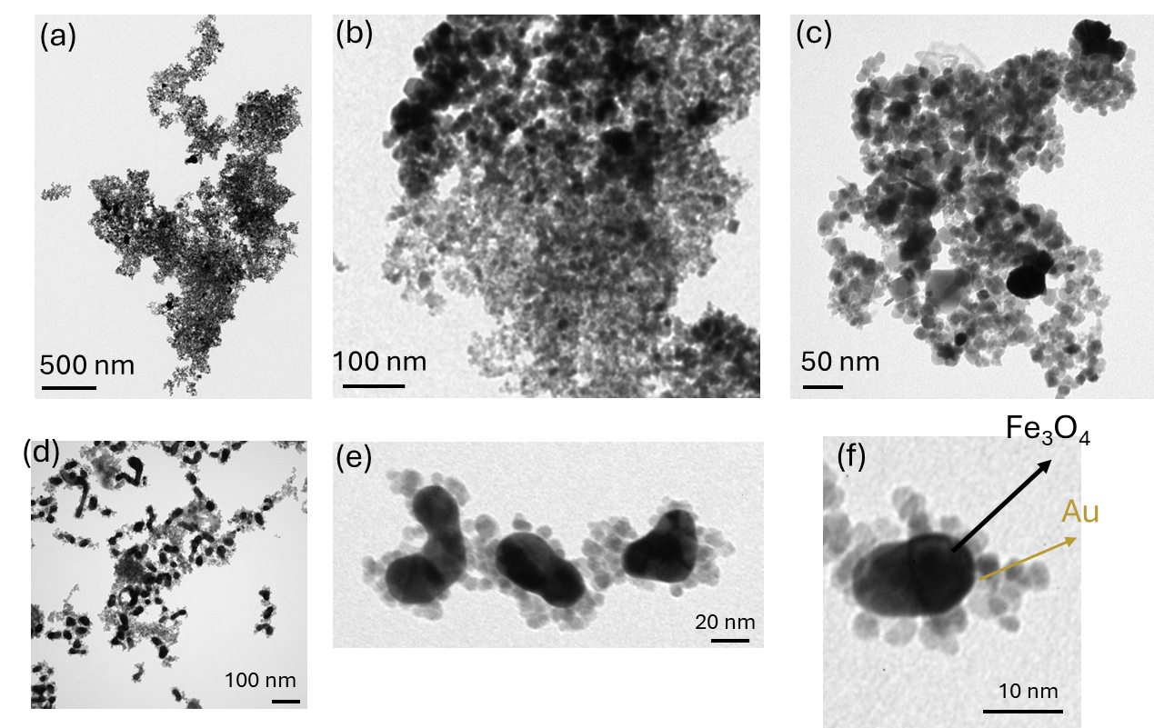
Structural Analysis
AuFe15
AuFe05
AuFe01
AuFe11
AuFe06
1
Notes:
TEM images revealed well-defined nanoparticles with a uniform distribution. The three TEM images in the first raw (a), (b) and (c) at different resolutions (500, 100, and 50 nm) show how Au -Fe₃O₄ NPs dispersed onto the IP6 matrix. The presence of IP6 as a stabilizer and a bridging agent assembles Fe₃O₄ nanoparticles (NPs) into a magnetic network nanostructure, which is easily dotted with Au nanoparticles (Au NPs). Low (d) and high (e and f) magnification of TEM images for core-shell Fe₃O₄@Au NPs depict the trend for clustering (d), as well as how gold shell covers the magnetite core (e and f).

Slide 4
Magnetic Characterization
 | H_{c} (mT) | M_{r} (Am²/kg) | M_{s} (Am²/kg)
AuFe01:Au decorated MNPs | 2.5 | 2.5 | 39
AuFe05: Core shell-1 | 3 | 3.5 | 32
AuFe11:Core shell-2 | 47 | 14 | 24
AuFe15: Core shell-3 | 4 | 0.1 | 8
AuFe06: Janus Particles | 6.5 | 0.4 | 4.5

Slide 5
Nanoparticle Synthesis Protocols
Core-Shell-2
Code Name | Concentration (mg/mL) |  |  | TEM (nm) | Hydrodynamic Properties (DLS) |  | Magnetic Properties (VSM@RT)
 | Total | Au | Fe₃O₄ |  | D_{H} (nm) | Zeta Potential (mV) | M_{s} (Am²kg⁻¹) | % M_{s} ²
AuFe11 | ?? | 0.20 | C_{1M} | 10-30@40-60 (15¹) | 160 (152²) | -70 (-49) | 24 | 27
AuFe16 | 1.03 | 0.20 | C_{2M} | (15¹) | 72 | ?? | ?? | ??
AuFe17 | 0.06 | 0.20 | C_{1M}/20 | ?? | 33 | -59 | ?? | ??
AuFe18 | 0.16 | 0.40 | C_{1M}/20 | ?? | 45 | -73 | ?? | ??
AuFe19 | 0.22 | 0.60 | C_{1M}/20 | ?? | 68 | -55 | ?? | ??
C_{2M} > C_{1M}
C1_{M}:diluted in 110 mL of ddWater
C2_{M}: Dense CitSPIONs solution
¹Stein et al.
²Bulk Fe₃O₄ M_{s}= 91 A m² kg⁻¹
**

Slide 6
WP2
Biomarkers binding and quantitative analysis
Results
Conjugation with Thrombin aptamers
AUTh

Slide 7
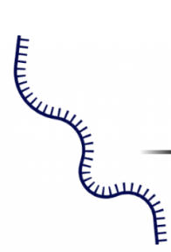
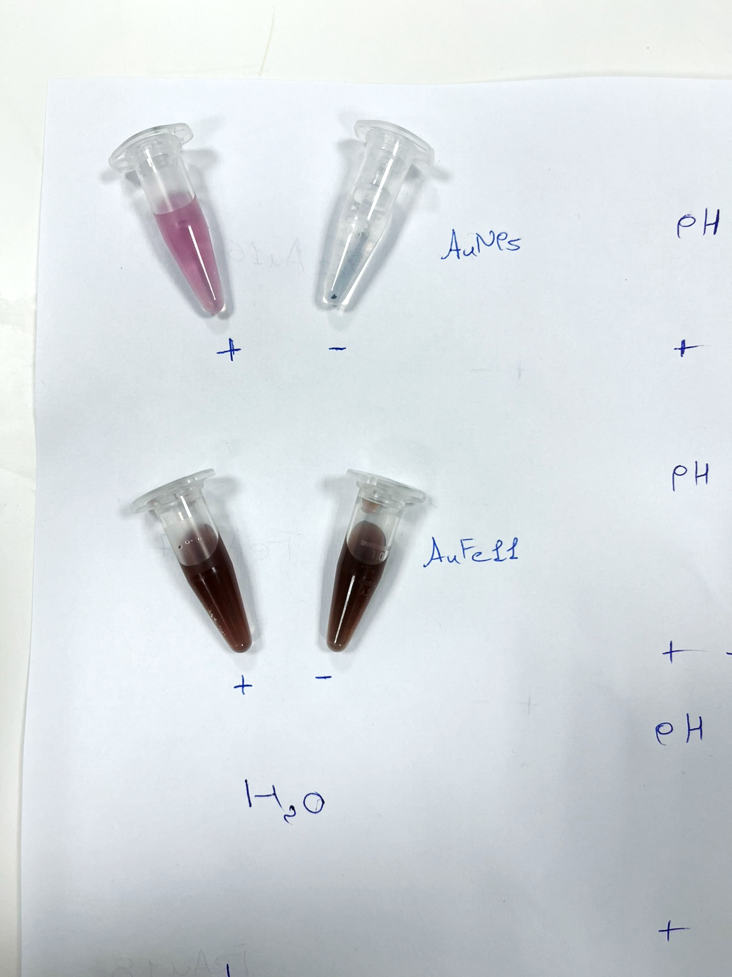
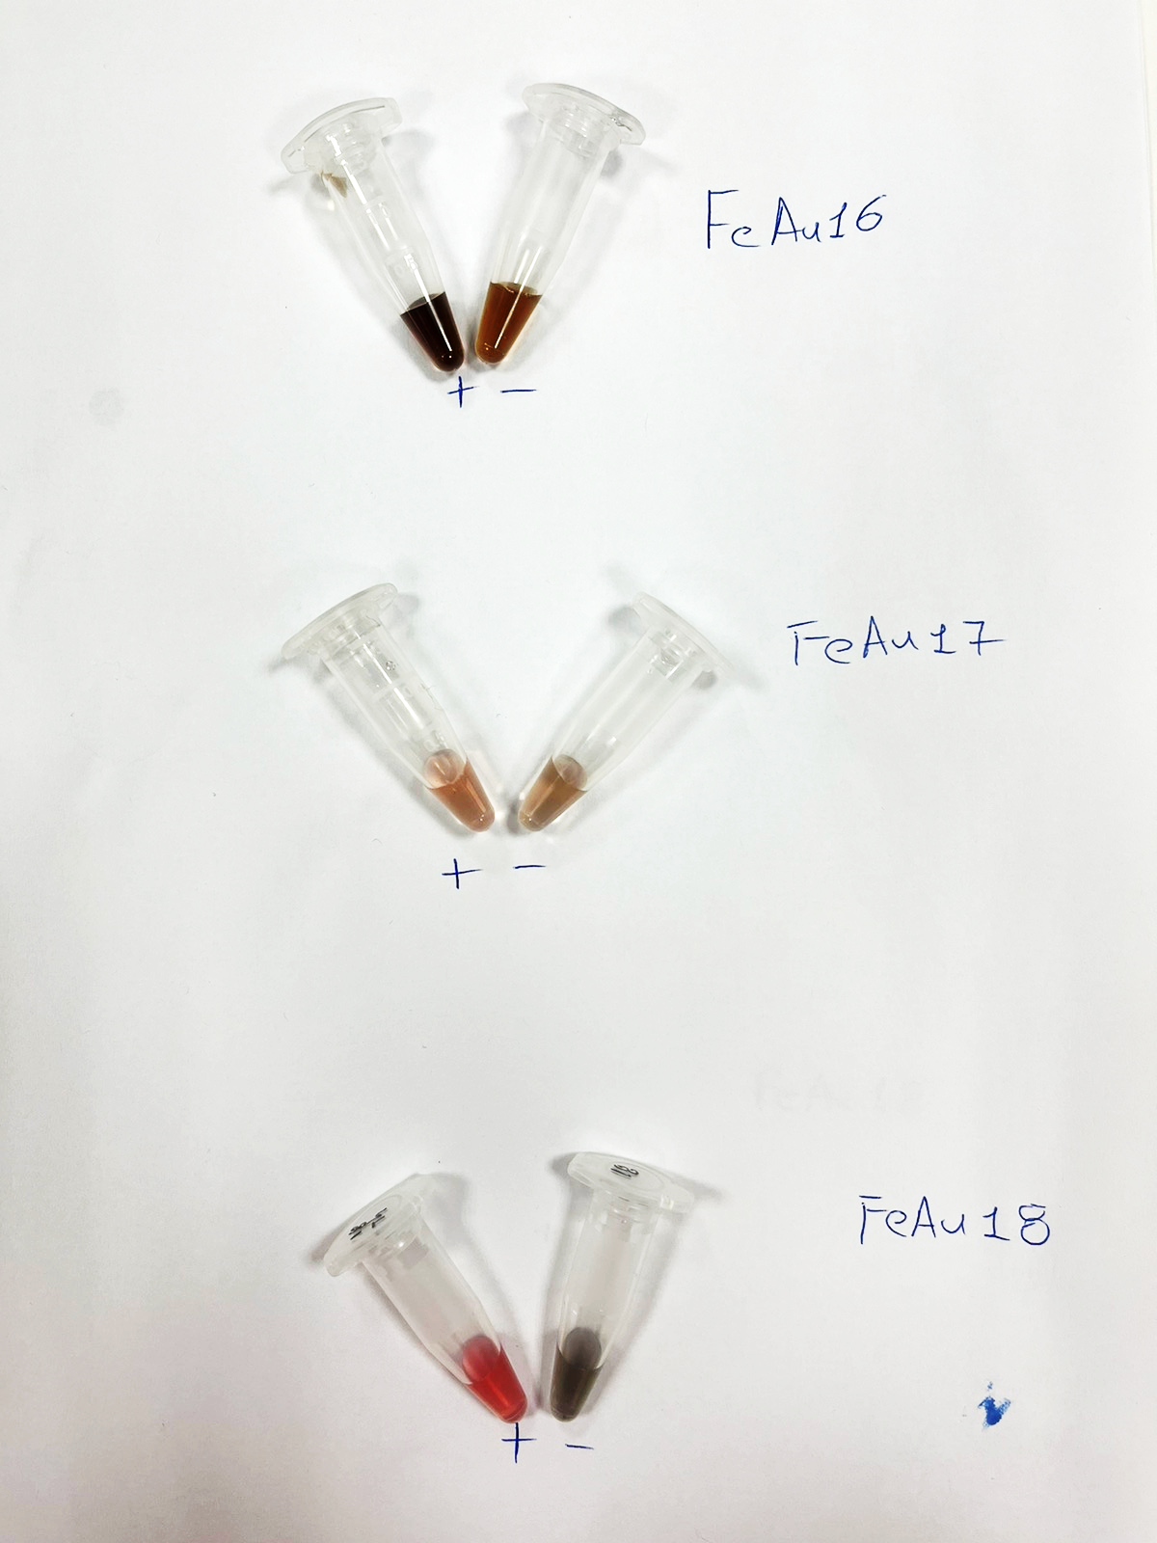
Thrombin Aptamer Conjugation
Aptamer sequence:5′-GGTTGGTGTGGTTGG-3′
Freeze-thaw protocol (overnight)
FAM determination at blue fluorescence
Aptamer Concentration: 1μM, Volume:12 μL
Au
0.16 mg/mL
Fe₃O₄: C_{1M}/20
Au: 0.6 mg/mL
Fe₃O₄: C_{1M}
Au: 0.2 mg/mL
1.03 mg/mL
Fe₃O₄: C_{2M}
Au: 0.2 mg/mL
Fe₃O₄: C_{2M}
Au: 0.2 mg/mL
0.06 mg/mL
Fe₃O₄: C_{1M}/20
C_{Au}: 0.4 mg/mL
72 nm
33 nm
45 nm
C_{2M} > C_{1M}
C_{1M}:diluted in 110 mL of ddWater
C_{2M}: Dense solution

Slide 8
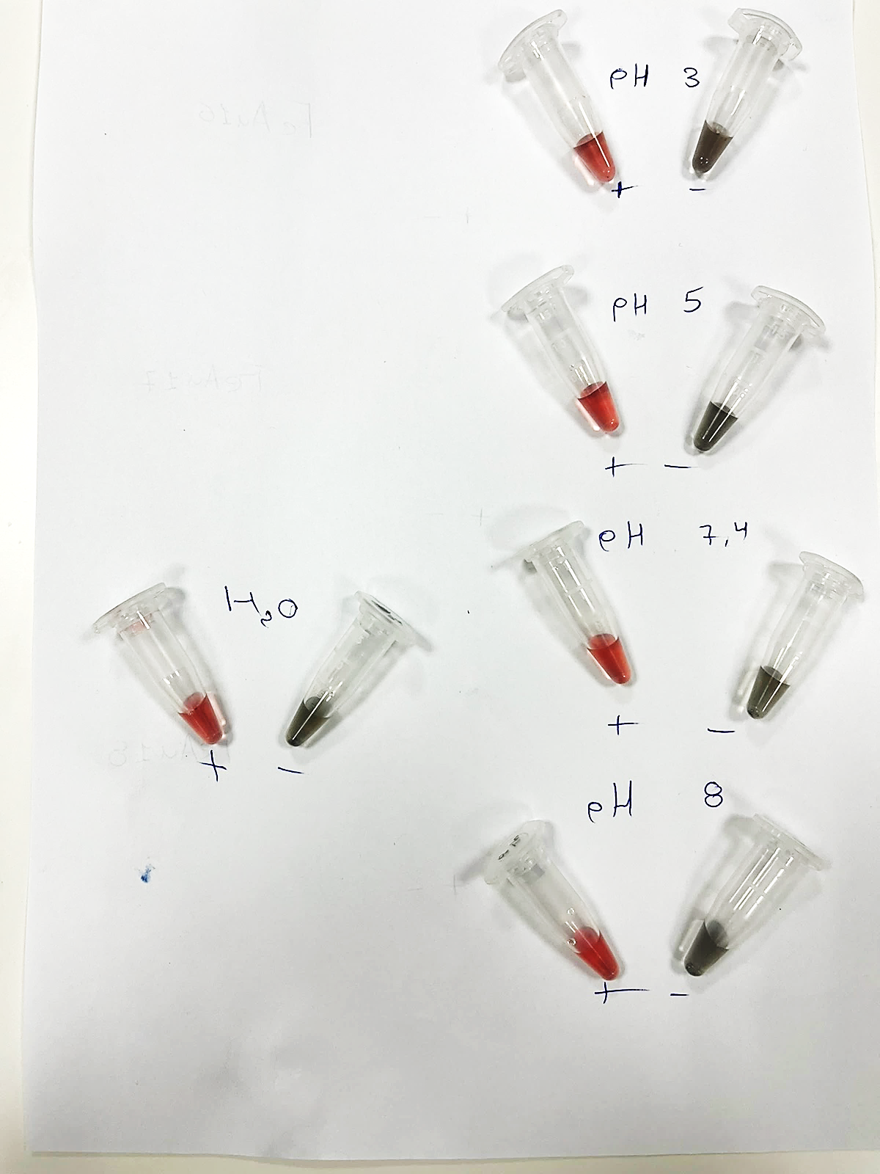
pH effect on conjugation
AuFe-18

Slide 9
WP2
Biomarkers binding and quantitative analysis
Protocols
Nanoparticle Synthesis
AUTh

Slide 10
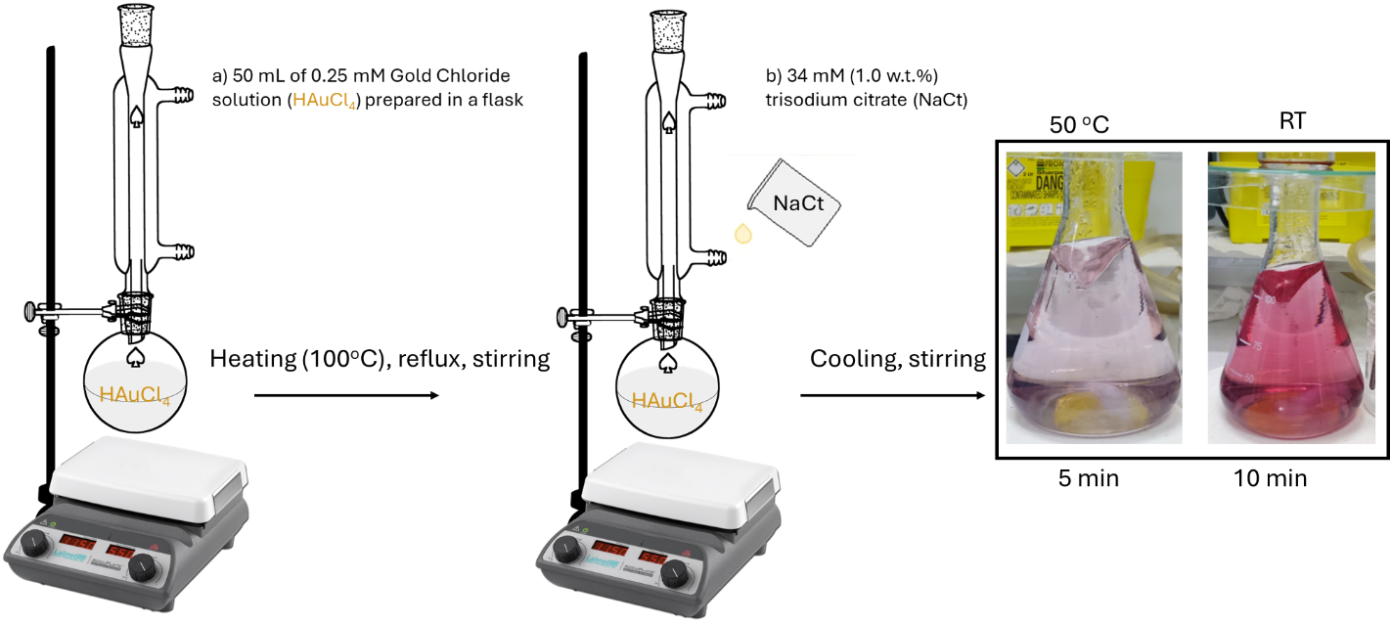
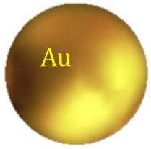
Synthesis
Au Reference
This synthesis is based on J. Dong et al. work (J. Dong et al. "Synthesis of precision gold nanoparticles using Turkevich method." KONA Powder and Particle Journal 37 (2020): 224-232, https://doi.org/10.14356/kona.2020011) and is used to fabricate the reference sample of Au-NPs. A schematic illustration of the synthetic procedure is given in Fig. 3.
Figure 3. Schematic illustration of the Turkevich method for synthesizing the reference Au nanoparticles. The process involves heating an HAuCl₄ solution, followed by the rapid injection of NaCt solution. The black box inset shows the final Au nanoparticles product, with a wine-red color indicating the presence of non-aggregated Au-NPs at room temperature, compared with the purple color of the dispersion at 50°C.

Slide 11
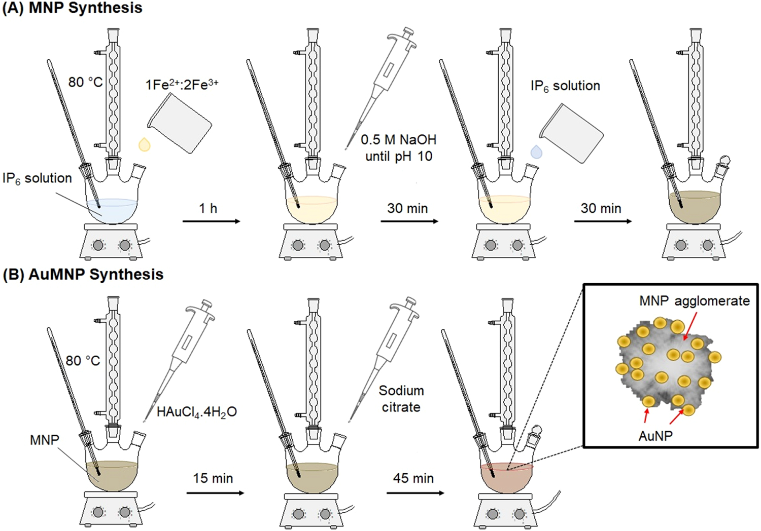
Synthesis
AuFe01
Au-decorated MNPs
Synthesis of magnetite nanoparticles and their conjugation with gold.
MNPs were synthesized via a coprecipitation method based on a previous work of Miyazaki et al.* with slight modifications from the procedure described by Yang et al.**
illustration of the Au-decorated MNPs
*Miyazaki et al. "Gold conjugated-magnetite nanoparticles for magnetic concentration towards reproducibility and repeatability of SERS measurements." Colloids Surf. A: Physicochem. Eng. 671 (2023): 131661, https://doi.org/10.1016/j.colsurfa.2023.131661)
**Yang et al. (T. Yang, et al. Au dotted magnetic network nanostructure and its application for on-site monitoring femtomolar level pesticide, Small 10 (2014) 1325–1331, https://doi.org/10.1002/smll.201302604)
Miyazaki et al.

Slide 12
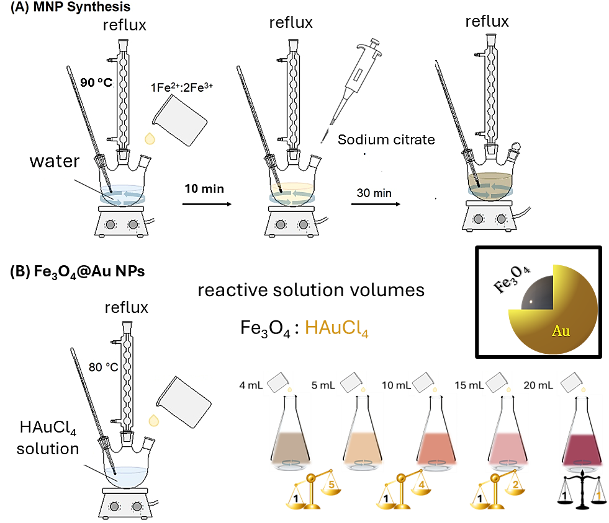
Synthesis
AuFe05
Core-Shell-1
Schematic representation of the core-shell structure of the resulting nanoparticles, with Fe₃O₄ forming the core and Au forming the shell.
2-stage co-precipitation synthesis *
1st Stage: Fe₃O₄ NPs
2nd Stage-Fe₃O₄–Au Core-Shell NPs
Illustration of step-by-step procedure of adding Fe₃O₄ nanoparticle solution to a boiling HAuCl₄ solution, under reflux, in varying volumes, followed by magnetic separation and washing.
15 nm
2 nm
*H. Zhou et al. "Ultrasensitive DNA monitoring by Au–Fe₃O₄ nanocomplex."
Sensors and Actuators B: Chemical 163.1 (2012): 224-232, https://doi.org/10.1016/j.snb.2012.01.040)
Hongjian, et al.

Slide 13
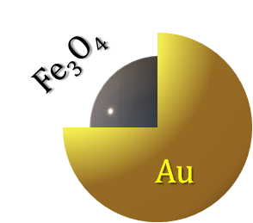
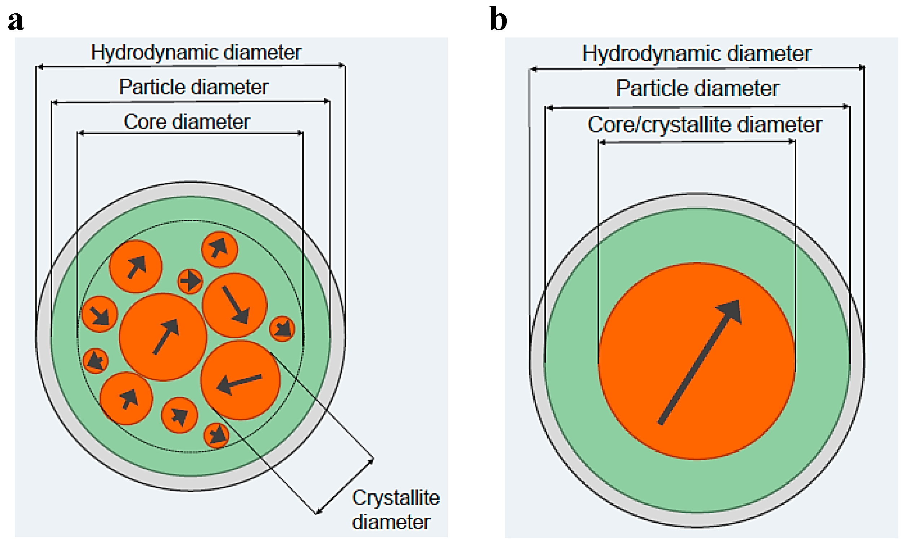
Synthesis
AuFe11
Core-Shell-2
Synthesis of Citrate-Stabilized and Gold-Coated MNPs*
To achieve enhanced long-term stability and size control over Au-MNPNs, sodium citrate was used in the second stage of synthesis to further stabilize the particles, creating Cit-Au-SPIONs.
1. Citrate-Stabilized SPIONs (Cit-SPIONs)
Iron Solution: Dissolve Fe(II) and Fe(III) salts in H₂O (13.2 mg Fe/mL) and deoxygenize with argon.
NH₃ Injection: Add 25% NH₃ (aq) to form SPION dispersion (black), stir for 10 min.
Citrate Addition: Add sodium citrate (293.3 mg/mL), stir at 90°C for 30 min.
Dialysis: Dialyze in H₂O for 6 hours, filter, and store at 4°C.
2. Gold-Coated SPIONs (Au-SPIONs)
Cit-SPION Preparation: Adjust iron concentration, deoxygenize with argon.
Gold Coating: Heat to 110°C, add HAuCl₄ solution. Color changes to deep red (15 min stirring).
Cool and Store: Cool to room temperature.
3. Citrate-Stabilized Gold-Coated SPIONs (Cit-Au-SPIONs)
After gold coating, add sodium citrate, stir briefly, and cool. Result: Cit-Au-SPIONs (enhanced stability).
D_{H}=152 nm
¹ R. Stein et al., Synthesis and Characterization of Citrate-Stabilized Gold-Coated Superparamagnetic Iron Oxide Nanoparticles for Biomedical Applications, Molecules 2020, 25(19), 4425; https://doi.org/10.3390/molecules25194425

Slide 14
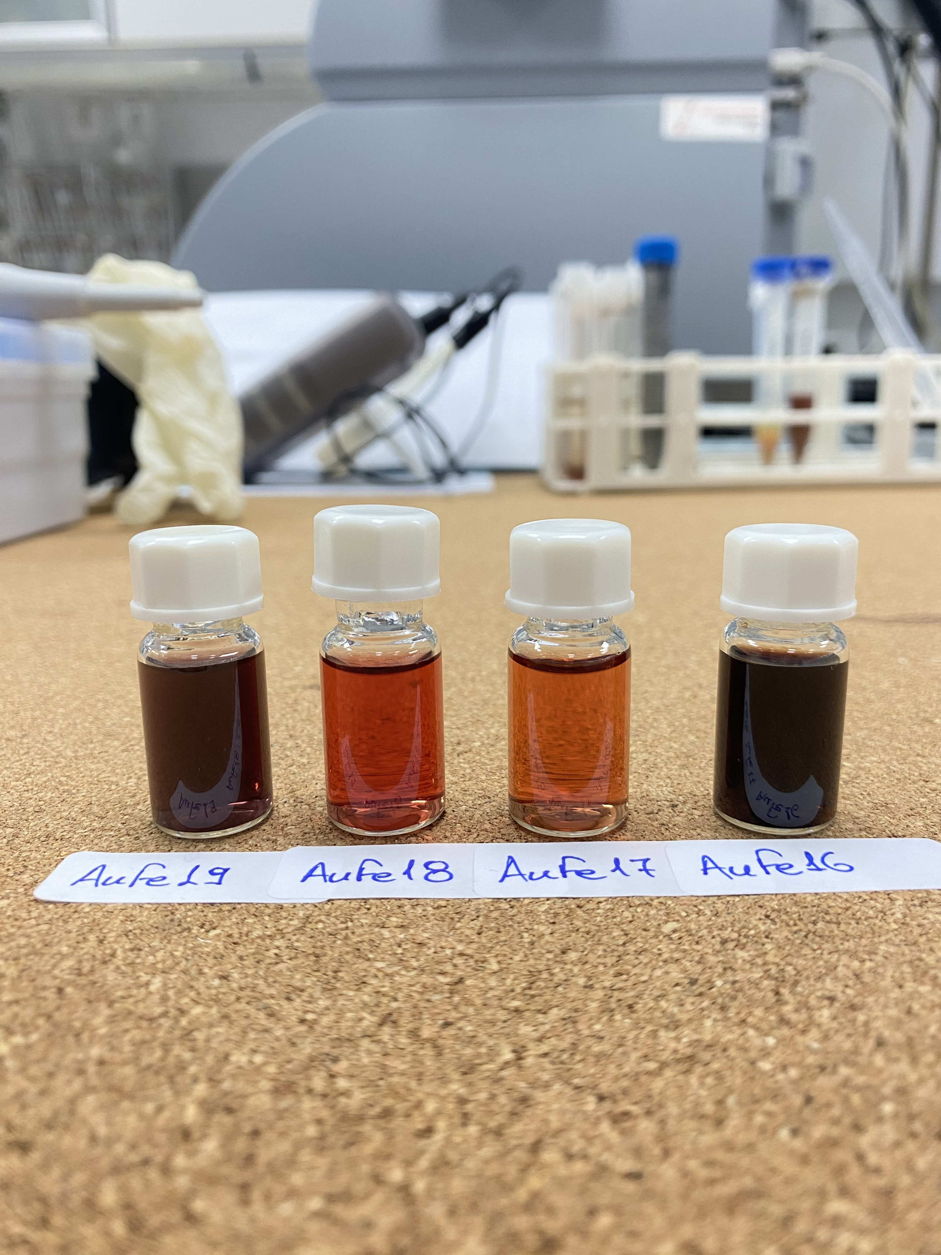
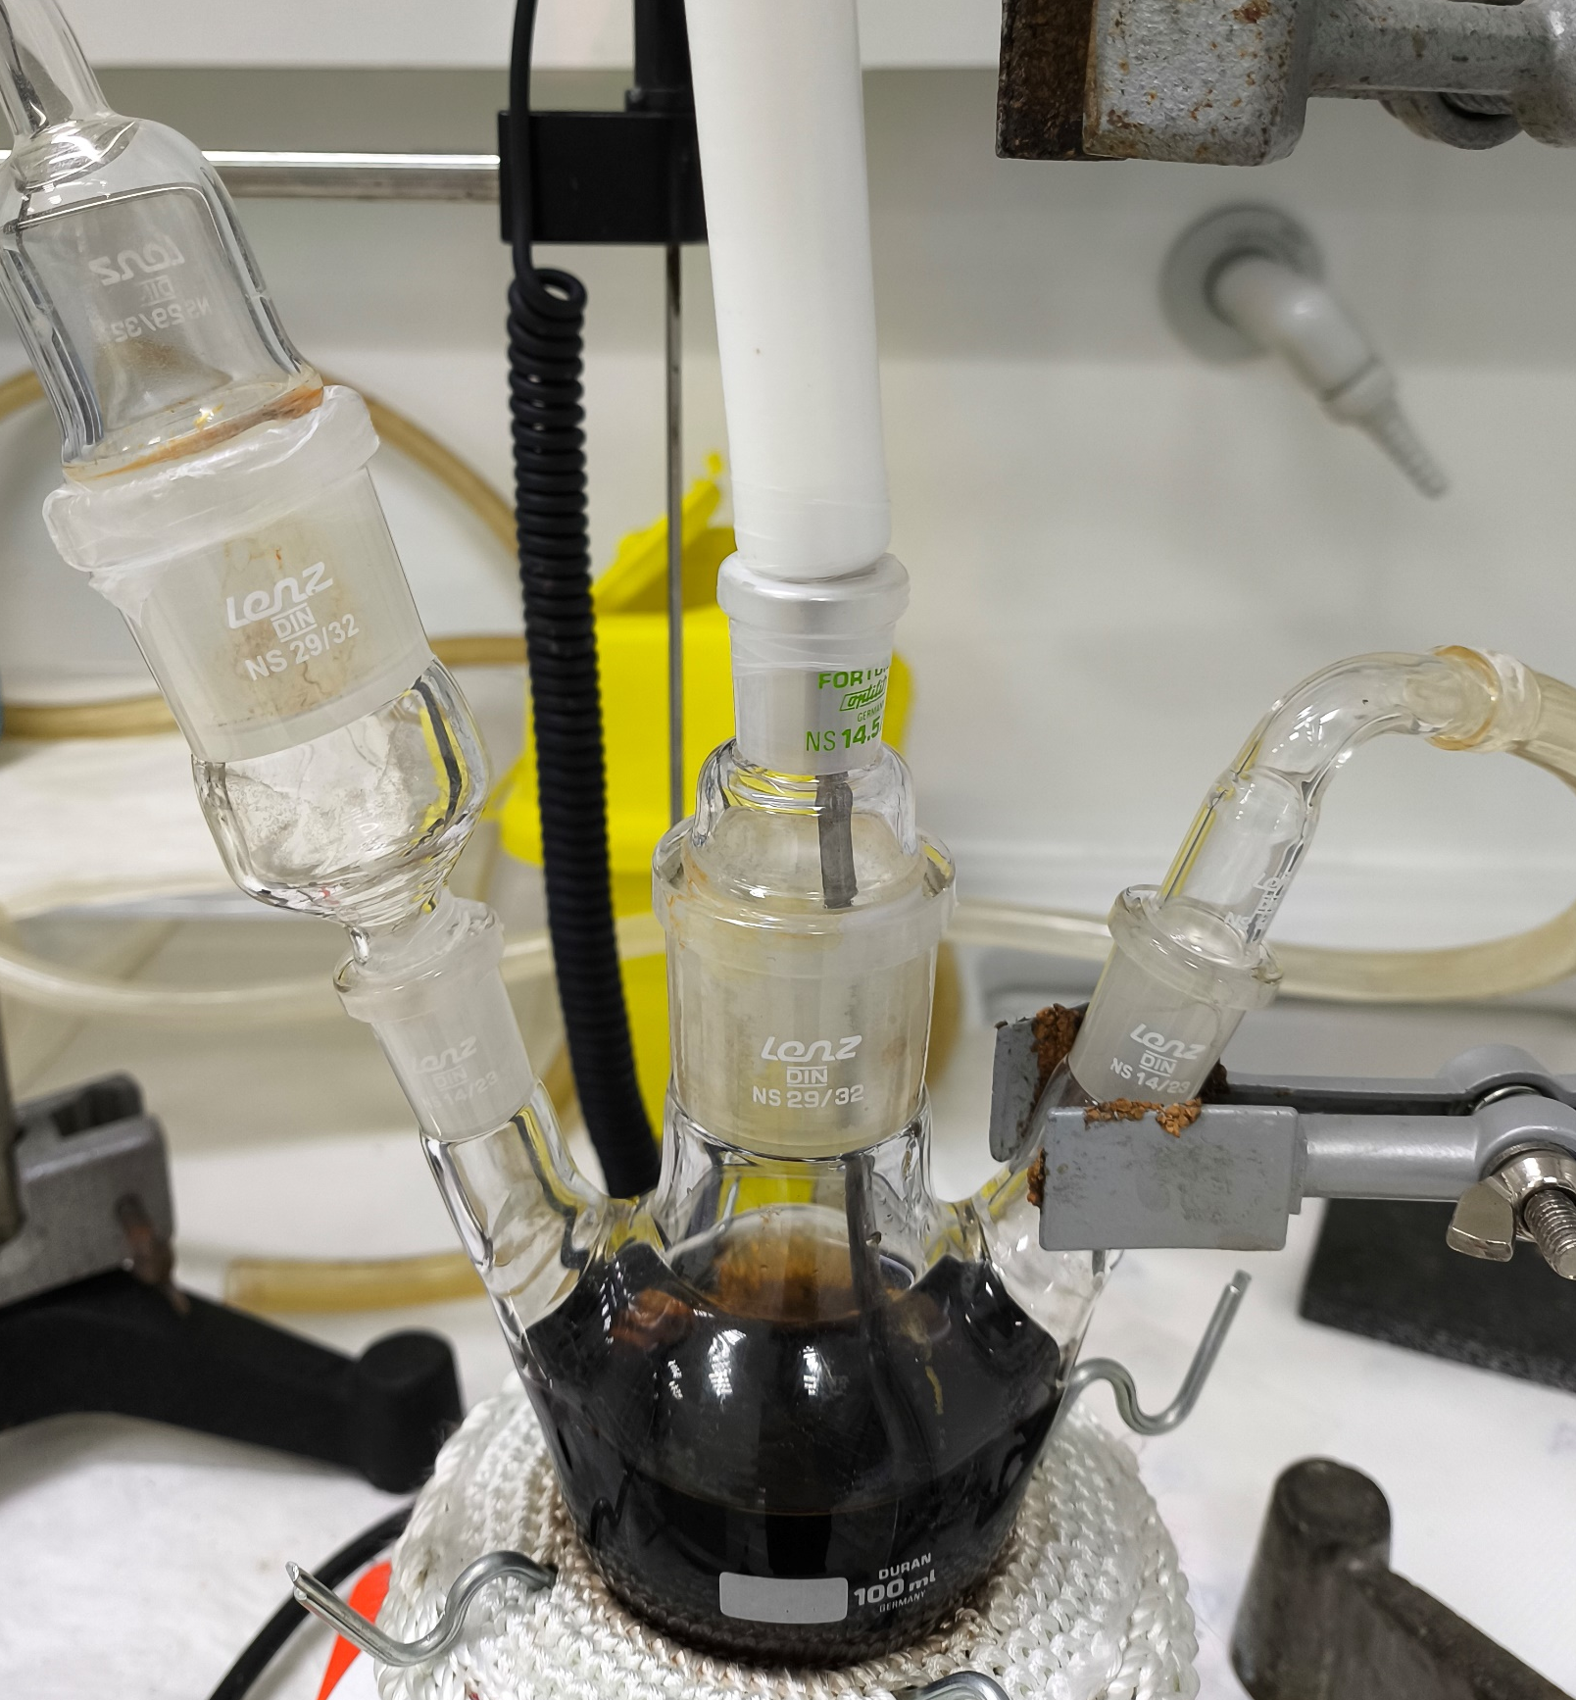
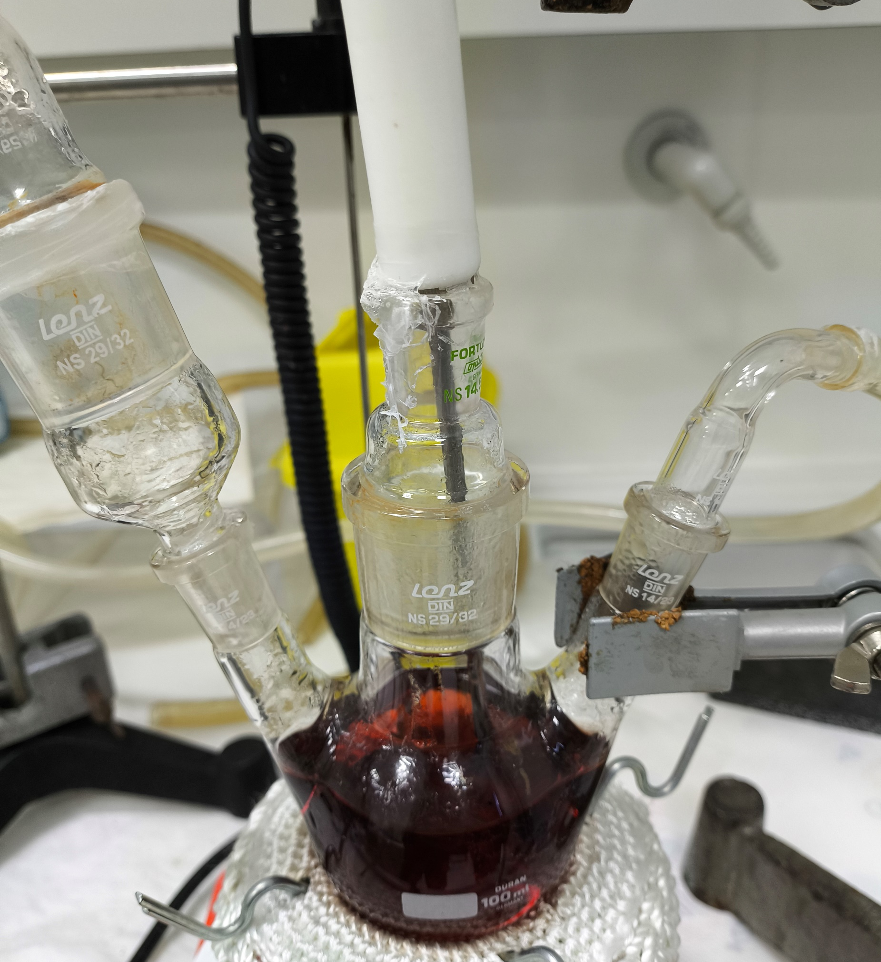
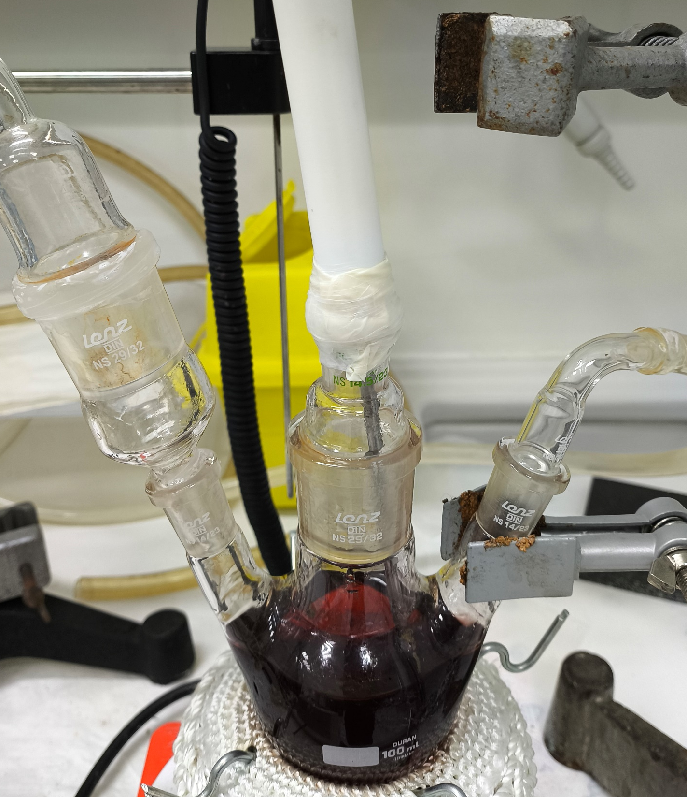
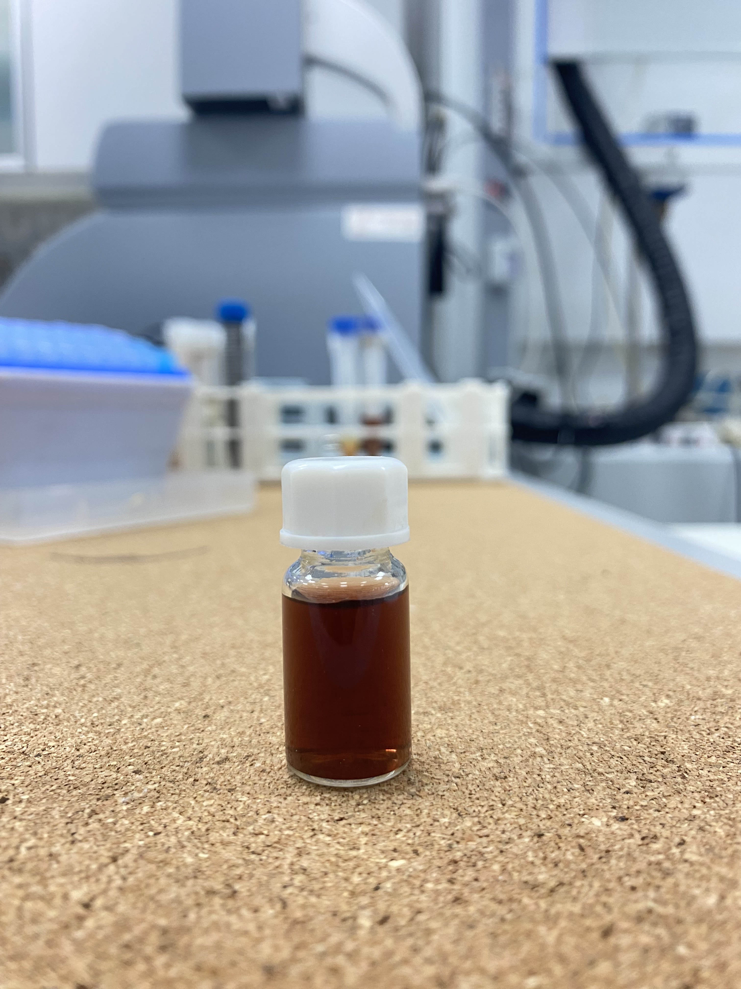

Synthesis
AuFe18
AuFe19
AuFe16
AuFe17
Core-Shell-2
AuFe11
AuFe16
AuFe17
AuFe18
AuFe19
Dense citFe₃O₄
x1 HAuCl₄
x2 HAuCl₄
x3 HAuCl₄
CitSPIONs
AuFe17
AuFe18
Figure 2. Illustration of the synthesis process for Fe₃O₄–Au core-shell nanoparticles. The diagram depicts the step-by-step procedure of adding HAuCl₄ solution to a boiling cit-Fe₃O₄ nanoparticle solution, under reflux, in varying volumes.
110 mL dd Water
AuFe11
160 mL HAuCl₄
0.2mg/mL
270 mL Solution in 500 mL three-necked flask

Slide 15
AuFe16
AuFe17
Synthesis
AuFe18
AuFe19
110 mL dd Water
AuFe11
160 mL HAuCl₄
0.2mg/mL
110 mL of CitSPIONs
270 mL Solution in 500 mL three-necked flask
AuFe16
160 mL HAuCl₄
0.2mg/mL
CitSPIONs
270 mL Solution in 500 mL three-necked flask

Slide 16
Synthesis
AuFe16
AuFe17
AuFe18
AuFe19
50 mL dd Water
4 mL of CitSPIONs +
76 mL of dd Water: diluted 1/20
20 mL HAuCl₄
x mg/mL
50 mL of CitSPIONs
100 mL Solution in 150 mL three-necked flask
HAuCl₄
x=0.2 mg/mL
HAuCl₄
x= 0.4 mg/mL
HAuCl₄
x= 0.6 mg/mL
AuFe17
AuFe18
AuFe19
x1 HAuCl₄
x2 HAuCl₄
x3 HAuCl₄

Slide 17
AuFe18
AuFe19
AuFe16
AuFe17
Synthesis
Core-Shell-2
AuFe11
AuFe16
AuFe17
AuFe18
AuFe19
Dense citFe₃O₄
x1 HAuCl₄
x2 HAuCl₄
x3 HAuCl₄
CitSPIONs
AuFe17
AuFe18
Fe₃O₄-Au NPs (Core-Shell) via 2-stage coprecipitation method
This synthesis is based on René Stein et al. previous work (“Synthesis and Characterization of Citrate-Stabilized Gold-Coated Superparamagnetic Iron Oxide Nanoparticles for Biomedical Applications, Molecules 2020, 25, 4425; doi:10.3390/molecules25194425), separated in two stages as illustrated in Fig. 2 and described as follows:
110 mL dd Water
160 mL HAuCl₄
0.2 mg mL
1st Stage-Synthesis of Cit-Fe₃O₄ Nanoparticles
2nd Stage-Synthesis of citFe₃O₄–citAu Core-Shell Nanoparticles
Figure 2. Illustration of the synthesis process for Fe₃O₄–Au core-shell nanoparticles. The diagram depicts the step-by-step procedure of adding HAuCl₄ solution to a boiling cit-Fe₃O₄ nanoparticle solution, under reflux, in varying volumes.

Slide 18
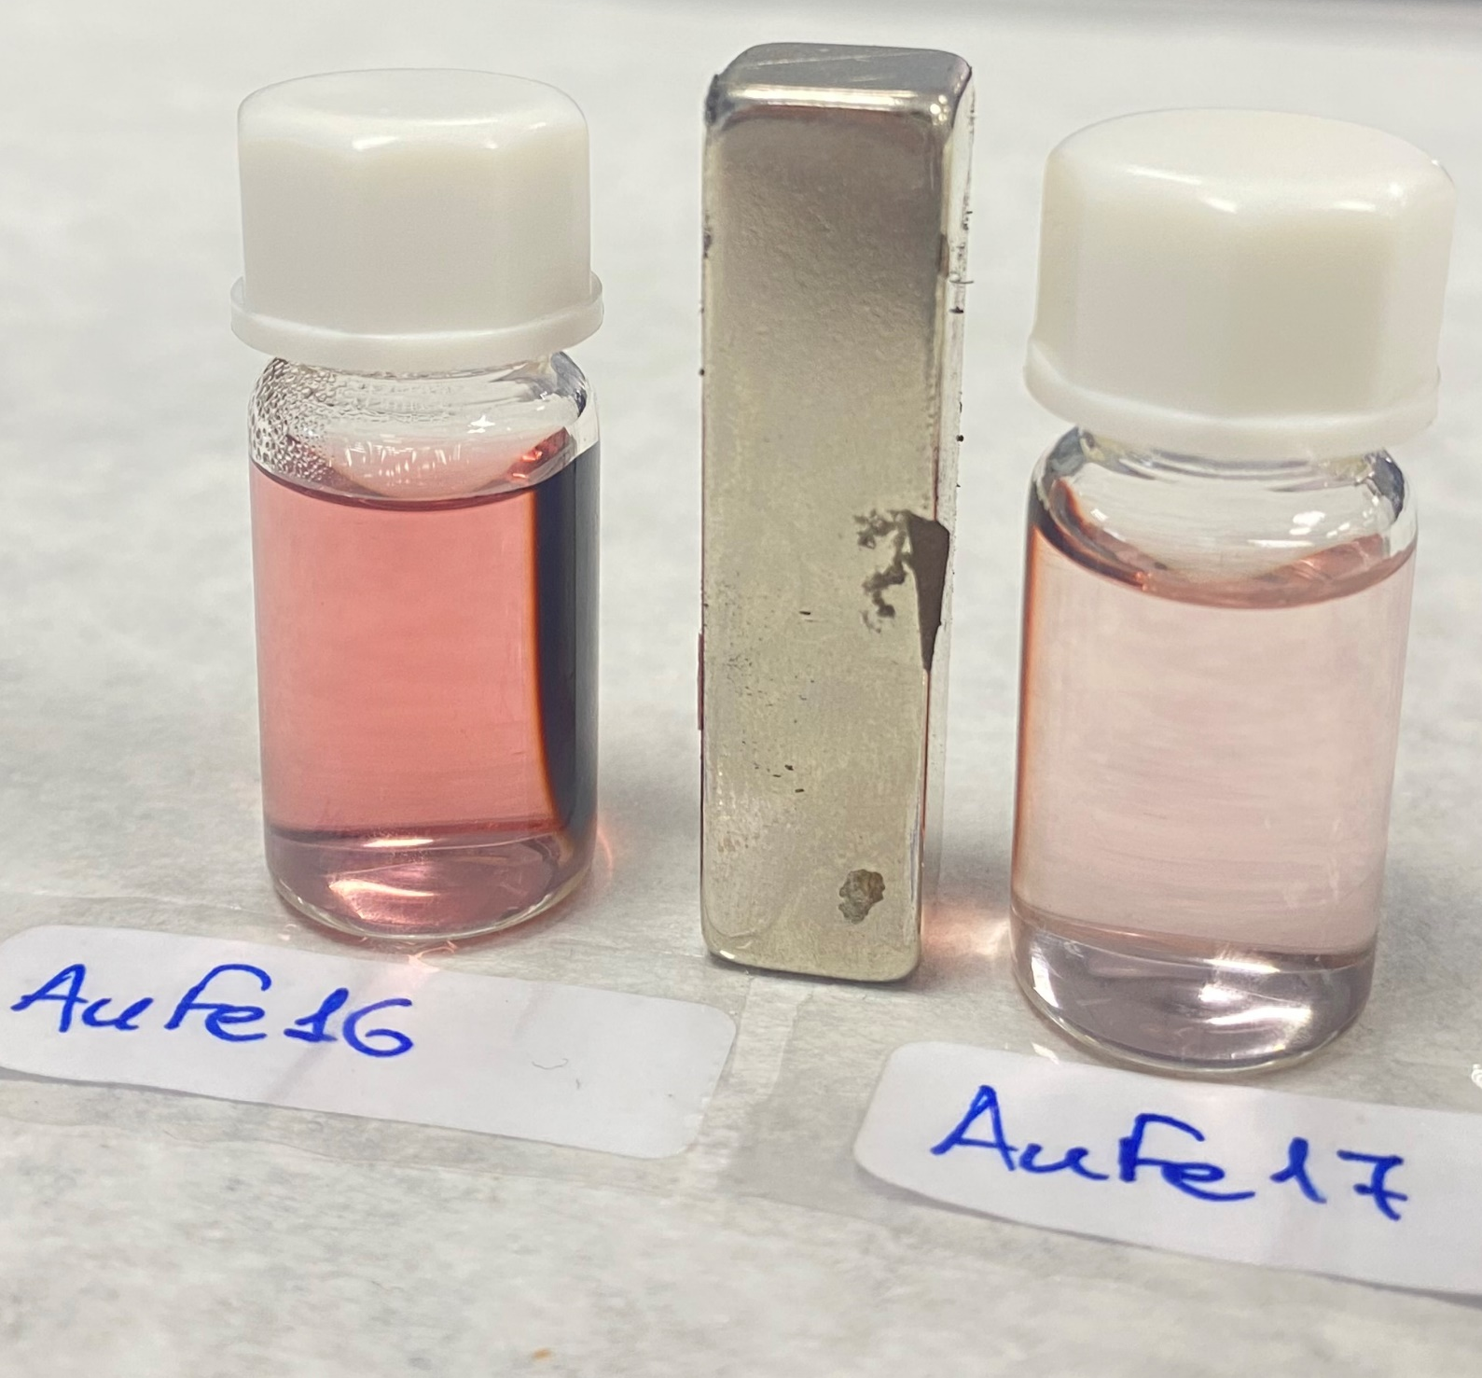
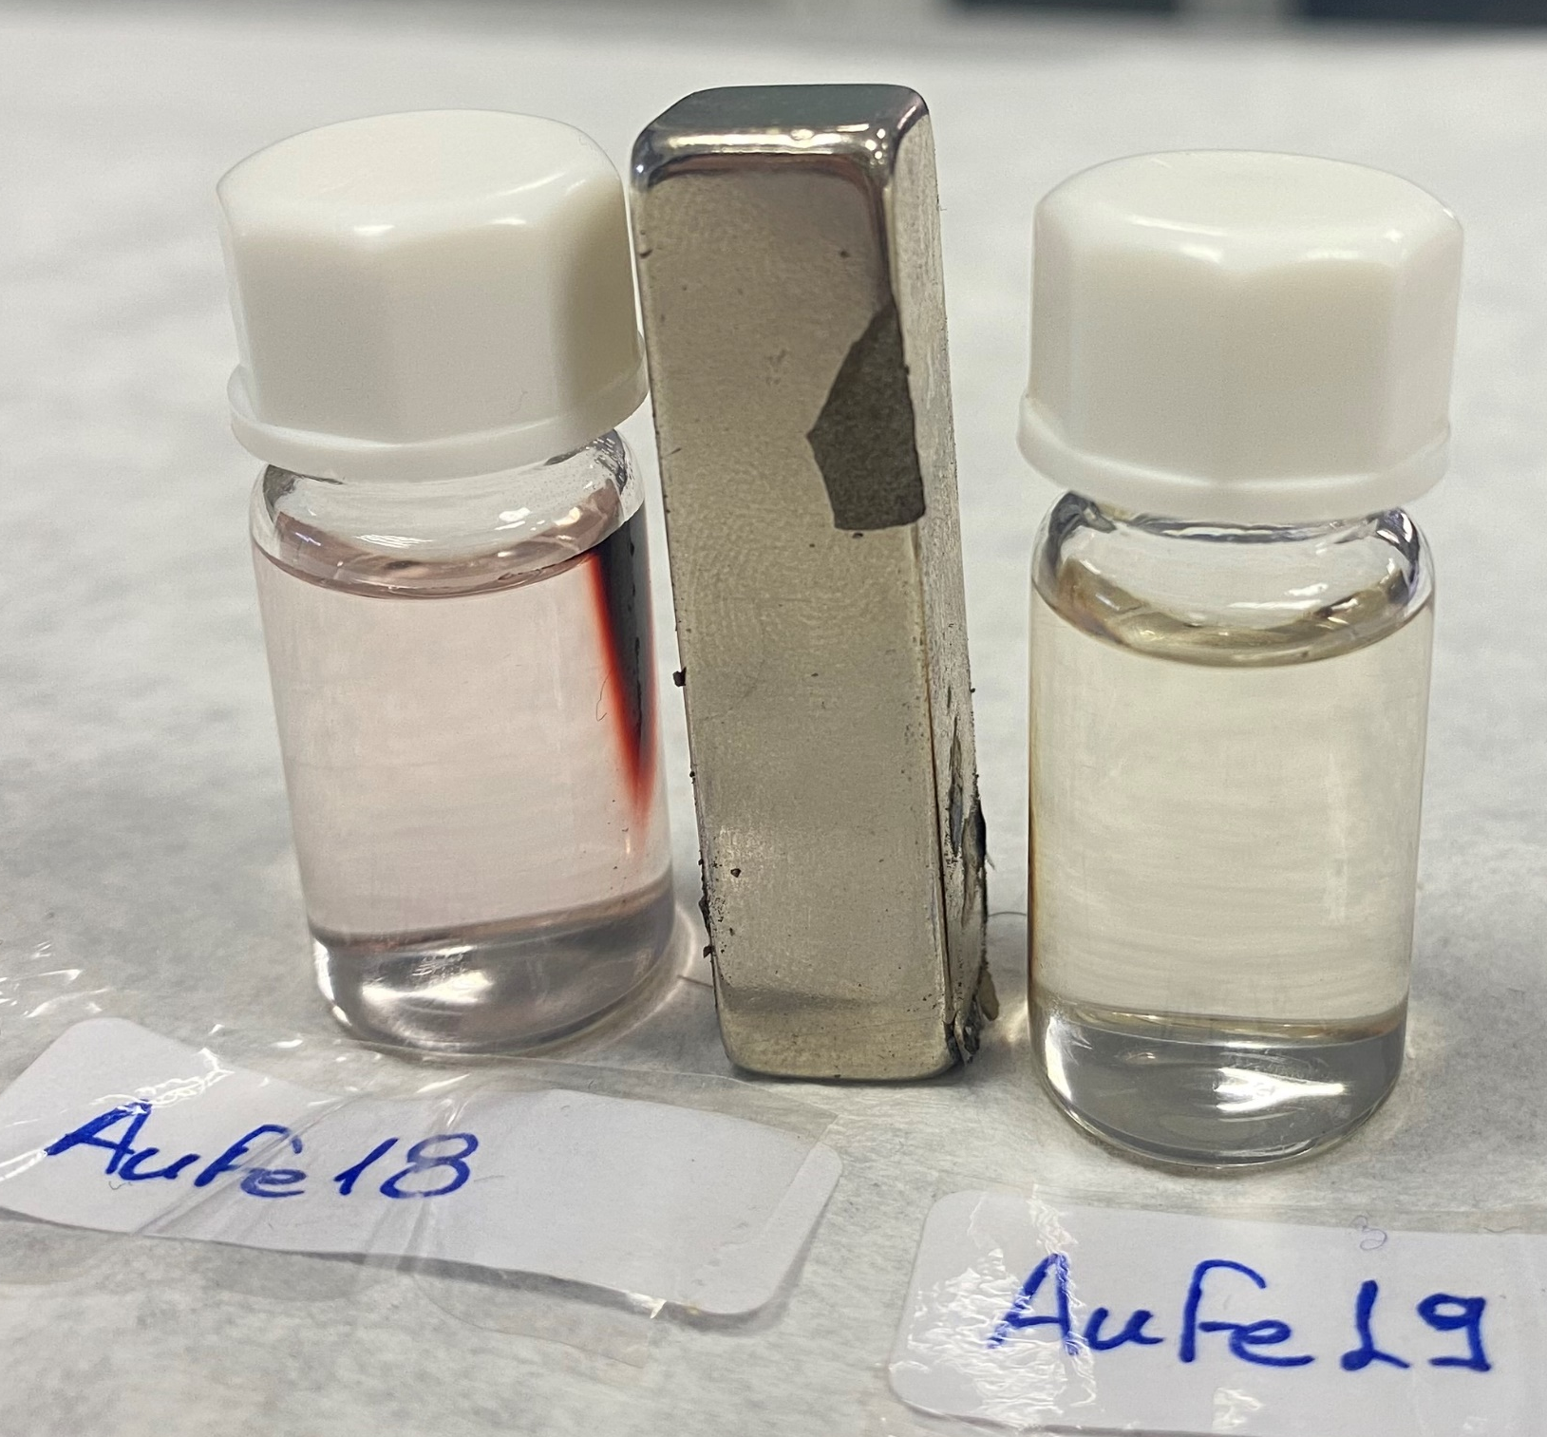
AuFe18
AuFe19
AuFe16
AuFe17
Synthesis
٭Different amounts of a HAuCl₄
AuFe16: citFe₃O₄ NPs centrifuged and magnetically separated and this dense solution was used for the 2nd step. 32mg HAuCl₄ in 160mL ddwater injected at once (this batch didn’t reach 90°C.) final concentration: ~ 1.03 mg/mL
AuFe17: Magnetically washed citFe₃O₄ NPs diluted in 50 mL and 4 mL of dispersion were injected in 76 mL of ddwater. Then 19,66 mL ddwater + 340μL (HAuCl₄ 10mg/mL) injected at once (this batch reached 95°C.) final concentration: ~ 0.06 mg/mL
AuFe18: Magnetically washed citFe₃O₄ NPs diluted in 50 mL and 4 mL of dispersion were injected in 76 mL of ddwater. Then 19,32 mL ddwater + 680 μL (HAuCl₄ 10 mg/mL) was injected at once (this batch reached 95°C.) final concentration: 0.16 mg/mL
AuFe19: Magnetically washed citFe₃O₄ NPs diluted in 50 mL and 4 mL of dispersion were injected in 76 mL of ddwater. Then 18,8 mL ddwater + 1,200 μL (HAuCl₄ 10 mg/mL) was injected at once (this batch reached 96°C.) final concentration: 0.22 mg/mL
AuFe11
AuFe16
AuFe17
AuFe18
AuFe19
Dense citFe₃O₄
x1 HAuCl₄
x2 HAuCl₄
x3 HAuCl₄
After 72 h with magnet
1.03 mg/mL
0.06 mg/mL
0.16 mg/mL
0.22 mg/mL

Slide 19
Synthesis
Core-Shell-3
The main difference is the use of pre-synthesized Au NPs instead of directly reducing Au onto Fe₃O₄. Sodium citrate acts as a reducing agent for Au in this process.
Core-Shell-3 Nanoparticles: A Three-Step Procedure
Synthesis of Fe₃O₄ NPs:
  Deoxygenated NaOH and H₂O₂ are sequentially added to FeSO₄·7H₂O under continuous N₂ bubbling, allowing for controlled concentrations.
Synthesis of Au NPs:
  Follows the Turkevich method, using sodium citrate as a reducing agent, with the reaction stopped upon observing a ruby-red color.
Synthesis of Au-Fe₃O₄ Hybrid NPs:
  Pre-synthesized Au NPs are incorporated into the Fe₃O₄ synthesis, replacing water, which distinguishes this process from earlier methods where Au was deposited directly.
Ochea et al.

Slide 20
Synthesis Protocols
Janus Particles
Synthesis of Fe₃O₄-Au Dumbbell MNPs
Preparation of Reaction Mixture:
  Solvent and Surfactants: Mix 100 mL of 1-octadecene, 10 mL of oleic acid, 10 mL of oleylamine, and 6.44 g of 1,2-hexadecanediol in a three-neck round-bottom flask under argon. Heat to 120 °C for 20 min.
Injection of Precursors:
  Iron and Gold Sources: Inject 1.5 mL of iron pentacarbonyl and 150 mg of hydrogen tetrachloroaurate (dissolved in 12.5 mL of 1-octadecene and 1.25 mL of oleylamine) into the heated mixture. Heat under reflux at 310 °C for 45 min, then cool to room temperature and air-expose for 1 h.
Isolation of MNPs:
  Precipitation and Drying: Isolate MNPs by adding isopropanol, followed by centrifugation at 6000 rpm for 10 min, and dry under vacuum.
Surface Modification with APTES:
  Amino Group Introduction: Coat MNPs with APTES by adding 100 mL of APTES and 50 μL of acetic acid to 10 mg of MNPs in 10 mL of toluene. Heat to 40 °C and stir overnight. Precipitate using a magnet, wash with deionized water, and redispersed in 9 mL of 0.1M PBS (pH = 8.3).

Slide 21
WP2
Biomarkers binding and quantitative analysis
Protocols
Conjugation with Thrombin aptamers
AUTh

Slide 22
Progress for each AuNPs synthesis
Nanoparticles | Code Name | Aptamers studied | Results/comments
Phytic Acid MNPs | AuFe01 Au-decorated MNPS - GMCP1 | ΤΒΑ1 (Thrombin) | Issues with aggregation Binding of aptamer not verified | Study could be repeated with the newest FAM-modified aptamers and more stable nanoparticles
Core shell AuMNPs | AuFe05 GMCP2 | TBA1 (Thrombin) | Issues with aggregation Binding of aptamer not verified | Study could be repeated with the newest FAM-modified aptamers and more stable nanoparticles
Core Shell AuMNPs | AuFe11 GMCP3 | TBA1 (Thrombin) RNV95 aptamer (Αβ40) Αβ7-92 aptamer (Αβ42) | Conjugation of all aptamers verified with fluorometry Issues with stability after 2 months (initially better binding than Au, but not replicated) | Study will be repeated after provision of fresh suspension Binding of peptides pending
Core Shell AuMNPs | AuFe15 GMCP4 | TBA1 (Thrombin) | Provided in dry form. Could not be resuspended | Study will be repeated after provision of fresh suspension
AuNPs | AuFe07 Au Reference-1 Au-ref AuFe08 Au Reference-2 GMCP4-Au Part | TBA1 (Thrombin) RNV95 aptamer (Αβ40) Αβ7-92 aptamer (Αβ42) | Conjugation of all aptamers verified with fluorometry Binding of Thrombin verified | Binding of amyloid peptides pending

Slide 23
Aptamer Conjugation on MNPs
We have employed two different types of modified aptamers:
C-terminal polyA10 tail modified aptamers
C-terminal thiolo(SH)-modified aptamers
We have also added a modification with fluorophore (FAM) for easier quantification of the bound/unbound aptamer
We have tested three alternative conjugation methodologies:
Slow “salt-aging” for 1-5 days of aptamers-nanoparticles mixes
Low-pH (3.0) assisted conjugation
Freeze-thaw assisted conjugation (2 hours and overnight freezing)

Slide 24
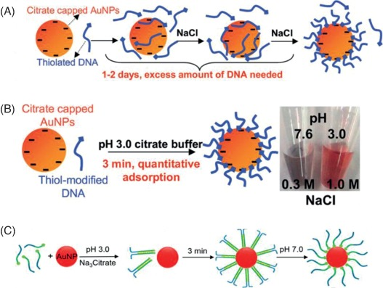
Salt-aging
Salt (NaCl) is very slowly added to the aptamer-nanoparticles mix (in a timeframe of 1-5 days), to induce binding of the aptamer to the citrate-capped nanoparticles
All attempts failed to retain the nanoparticles dispersity (possibly due to non-stable initial syntheses)
Primal biochemical analyses did not prove significant binding efficiency, and the reproducibility was poor
Too many parameters to define (time, temperature, pH, salt concentration, aptamer concentration, nanoparticles concentrations etc)
Very large excess of aptamer needed for quantitative reaction (according to literature)

Slide 25
Low pH – assisted conjugation
SH-aptamers are mixed with citrate-capped nanoparticles, and an acidic buffer is added to induce quick adsorption of aptamers on gold nanoparticles
This protocol is fast and leads to quantitative conjugation of aptamers on Au NPs (according to literature)
We employed this methodology in initial syntheses (AuFe01-GMCP1, AuFe05-GMCP2) but failed (possibly due to low stability of these nanoparticles)
We repeated this methodology with core-shell MNPs (AuFe11-GMCP3) successfully

Slide 26
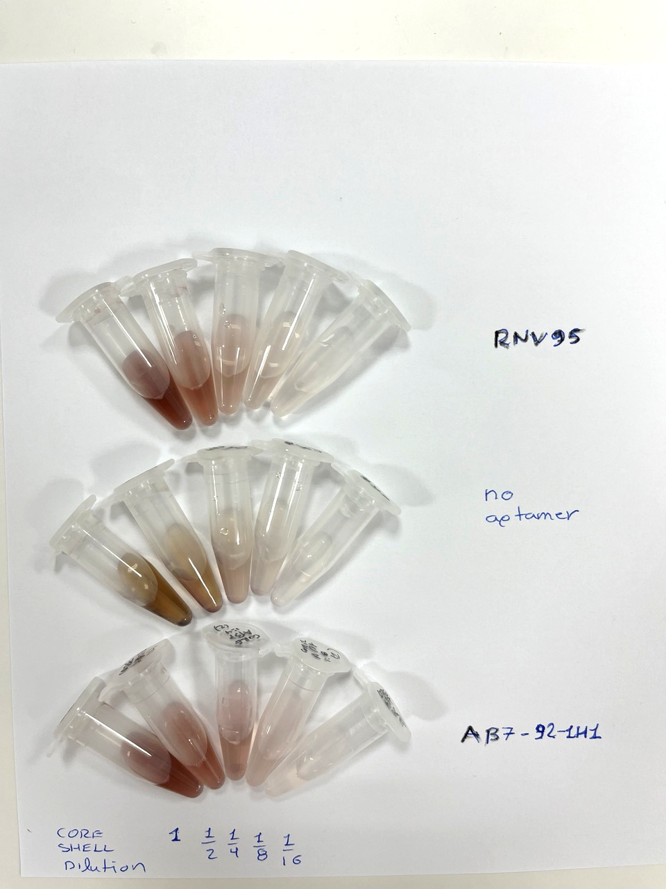
Nanoparticles treated with low-pH citrate buffer in the absence of aptamers aggregated as proved by intense color change and sedimentation of the core-shell MNPs (AuFe11-GMCP3) at the bottom of the tube
NO APTAMER
Au NPs (AuFe07, AuFe08) in the presence of aptamers (2 μΜ) retained their initial dispersity and color, indicative of aptamer conjugation on Au NPs (AuFe07, AuFe08) and protection against aggregation induced by the low-pH treatment
Αβ7-92 aptamer (Αβ42)
RNV95 aptamer (Αβ40)
Serial Dilutions of core-shell MNPs (AuFe11-GMCP3) (up to 16-times dilution)

Slide 27
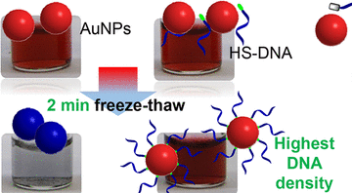
Freeze-thaw directed conjugation
SH-aptamers are mixed with citrate-capped nanoparticles, and then frozen (-20) and thawed after at least 2 hours (overnight is OK also)
This protocol is fast, easy and leads to quantitative conjugation of aptamers on Au NPs (according to literature)
We employed this methodology in gold nanoparticles (AuRef1, AuRef2) and core-shell MNPs (AuFe11-GMCP3) with success

Slide 28
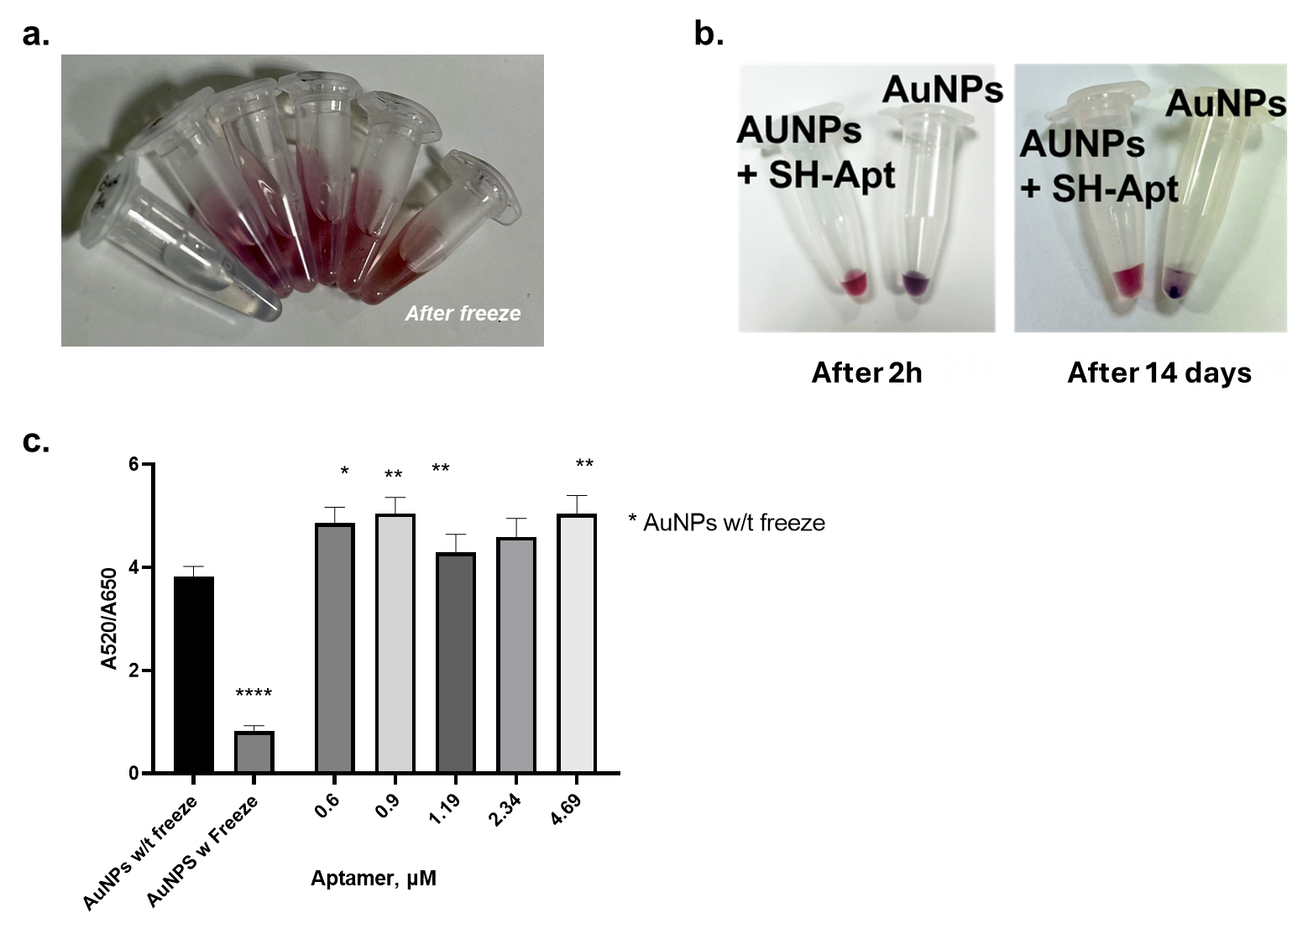
Au NPs (AuRef2) treated with freeze-thaw in the absence of TBA1 aptamers aggregated as proved by intense color change and sedimentation of the AuNPs at the bottom of the tube
AuNPs treated with TBA1 were stable for at least 2 weeks

Slide 29
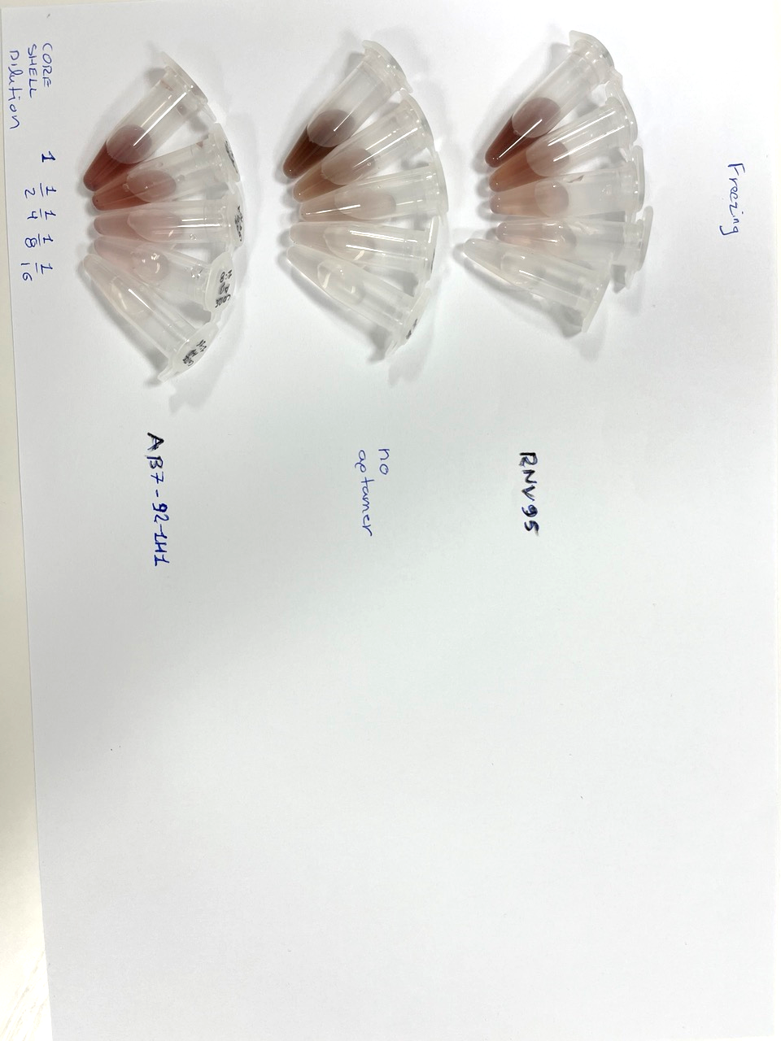
Core-shell MNPs (AuFe11-GMCP3) treated with freeze-thaw in the absence of aptamers presented a slight color change and sedimentation at the bottom of the tube
Au NPs (AuFe07, AuFe08) in the presence of aptamers (2 μΜ) retained their color and did not aggregate.
The change in color was not so intense as with low-pH treatment conjugation
NO APTAMER
Αβ7-92 aptamer (Αβ42)
RNV95 aptamer (Αβ40)
Serial Dilutions of Core shell MNPs (AuFe11-GMCP3) (up to 16-times dilution)
29

Slide 30
Comparing freeze-thaw and low-pH
In most of the core-shell MNPs (AuFe11-GMCP3) dilution, freeze-thaw had better results
We decided to continue with freeze-thaw protocol in the following experiments
polyA10-aptamers did not bind to any NPs tested, so we dropped them and continue only with SH-aptamers

Slide 31
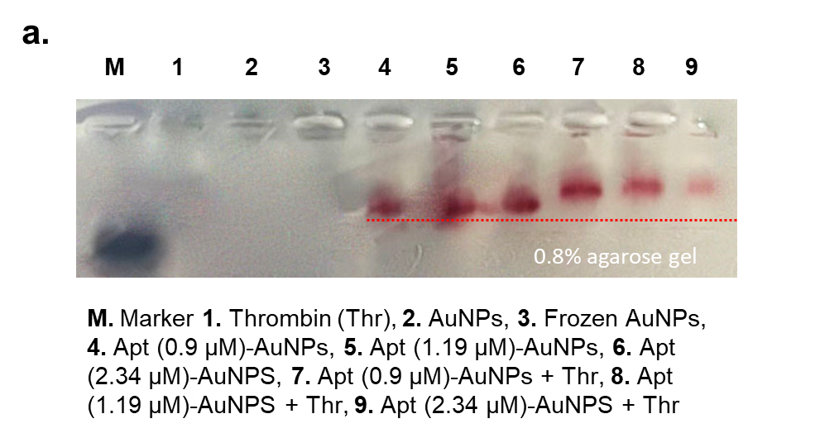
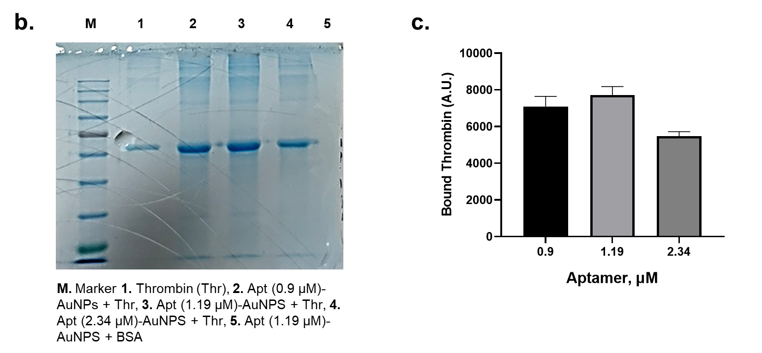
Thrombin binding on TBA1-AuNPs
Thrombin binding on TBA1-AuNPs (AuFe08) is verified by electrophoretic analyses (agarose and polyacrylamide gel)
These results are currently replicated with core-shell MNPs (AuFe11-GMCP3)

Slide 32
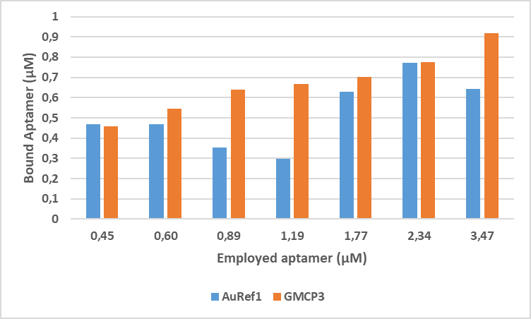
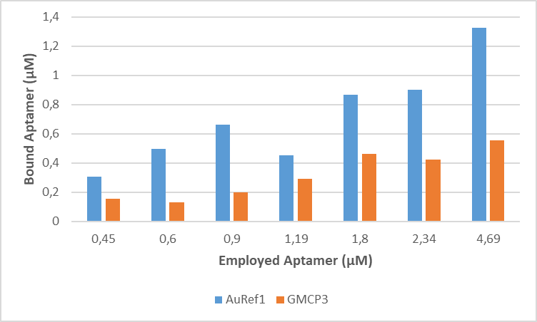
Reproducibility issues with Core-Shell
Fresh NPs
2 months later
Binding of TBA1 on AuNPs (AuRef1) was similar, but at core-shell (AuFe11-GMCP3) binding efficiency was lower

