Slide 1
2nd Project Meeting
17-18/04/2024
Barcelona, Spain
Progress on WP2 – Biomarkers binding and quantitative analysis
Makis Angelakeris, Professor, Physics
Aristotle University of Thessaloniki

Slide 2

Outline
1
Identity, timeline
2
Implementation and overall progress per task
3
Issues for discussion
4
Questions & Answers

Slide 3
WP2 Biomarkers binding and quantitative analysis
Identity, timeline

Slide 4

Identity, timeline and overall progress
Objectives
Identification, synthesis, functionalization, and optimization of DNA aptamers for AD protein biomarkers.
Identification, synthesis, characterization, and evaluation of MNPs as carriers and enablers.
Conjugation of aptamers, MNPs, and Biomarkers with AD protein biomarkers.
Evaluation and validation of individual and conjugated components.
WP2 Biomarkers binding and quantitative analysis
Issues for discussion

Slide 5
Identity, timeline and overall progress
Deliverables
12th month | D2.1 | Conjugated MNPs/Aptamers Design, Synthesis, and Selection, Version 1
24th month | D2.2 | Conjugated MNPs/Aptamers Design, Synthesis, and Selection, Version 2
18th month | D2.3 | Conjugated MNPs/Aptamers Binding to AD Biomarkers evaluation, Version 1
30th month | D2.4 | Conjugated MNPs/Aptamers Binding to AD Biomarkers evaluation, Version 2
WP2 Biomarkers binding and quantitative analysis
Issues for discussion

Slide 6

Identity, timeline and overall progress
TimeLine
WP2
M4: Jan2024
M12:Sep2024
D2.1 v1
M18:Mar2025
D2.2 v1
M24: Sep2025
D2.1 v2
M30:Mar2026
D2.2 v2
D2.1 Conjugated MNPs/Aptamers
D2.2 +Binding to AD

Slide 7
WP2 Biomarkers binding and quantitative analysis
Implementation and overall progress per task

Slide 8
Implementation and overall progress
TimeLine
Task 2.1: M4-M24 | Identification, synthesis, and evaluation of Aptamers for AD protein biomarkers | Leader: NOVA, support: AUTH, CeADAR
Task 2.2: M13-M24 | Optimization and functionalization of aptamers | Leader: NOVA, support: AUTH, CeADAR
Task 2.3: M4-M24 | Synthesis and characterization of magnetic nanoparticles as carriers and enablers | Leader: AUTH, support: NOVA
Task 2.4: M18-M30 | Immobilization, Functionalization & Evaluation of Conjugated MNPs/Aptamers/Biomarkers | Leader: AUTH, support: UP, ICN2, NOVA

Slide 9







Implementation and overall progress
Task 2.4
Tasks 2.1, 2.2
Task 2.3
Contacts
Makis Angelakeris
AUTh
NatasaPantazaki
AUTh
Cristian Bosch Serrano
CeADAR
Jean-Jacques TOULMÉ
NOVAptech
Marianna Rossetti
ICN2
Aris Bakandritsos
UP
Ruslan Alvarez
ICN2

Slide 10


Implementation and overall progress
Task 2.1: Identification, synthesis, and evaluation of Aptamers for AD protein biomarkers
Identification of aptamers for AD protein biomarkers (indicatively Aβ₁₋₄₀, Aβ₁₋₄₂, tau₁₈₁, tau₂₁₇ tau₂₃₁, NFL, GFAP) through a literature review and search in databases for all the available sequences of DNA aptamers.

Slide 11

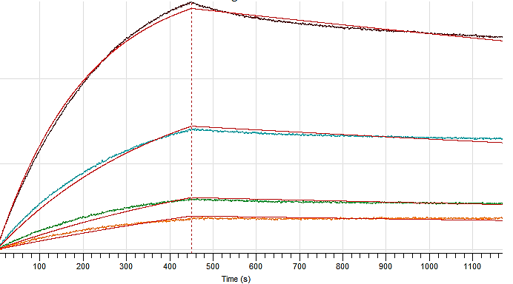
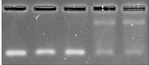
Implementation and overall progress
Task 2.1: Identification, synthesis, and evaluation of Aptamers for AD protein biomarkers
Binding/affinity evaluation of literature aptamers with Aβ peptides by-
Surface Plasmon Resonance (SPR)
Bio-layer Interferometry (BLI)
Electrophoretic mobility shift assay (EMSA)
Start the new aptamer selection
Progress so far-
Testing of literature aptamers is complete
Aptamer selection underway for Aβ₄₀ and Aβ₄₂
If no binding/interaction
observed

Slide 12


Implementation and overall progress
Task 2.1: Identification, synthesis, and evaluation of Aptamers for AD protein biomarkers
Comparative study of their characteristics together with binding and evaluation techniques proposed.

Slide 13
Implementation and overall progress
Task 2.1: Identification, synthesis, and evaluation of Aptamers for AD protein biomarkers
The evolution of the pools will be monitored by NGS sequencing (Next Generation Sequencing), and the sequences analysed with a proprietary algorithm.
Candidates chosen on the basis of the bioinformatics analysis will be chemically synthesized and their binding to proteins characterized by SPR or BLI (detection of biomolecular interactions in real-time).

Slide 14

Implementation and overall progress
Task 2.1: Identification, synthesis, and evaluation of Aptamers for AD protein biomarkers
Methodology | Functionalities¹ | Limitations Rating² | Suitability³
MLPD, 2021 | +++ | ++ | Seeking a direct bridge between experimental techniques and computational refinement.
RaptGen, 2022 | +++ | + | Ideal for exploring novel sequences through generative methods, with a focus on motif representation.
AptaNet, 2021 | ++ | ++ | Appropriate for those focusing on predicting interactions without the need to generate novel sequences.
APIPred, 2023 | + | ++ | Suitable for targeted prediction tasks, though details are less clear compared to others.
AptaBERT, 2023 | +++ | + | Highly effective for understanding complex interactions and discovering new targets, requires substantial data.
AptaTrans, 2023 | +++ | ++ | Optimized for transforming experimental data into high-affinity candidates, particularly efficient in enhancing the selection process through its unique model-guided mutation strategy.
The evolution of the pools will be monitored by NGS sequencing (Next Generation Sequencing), and the sequences analysed with a proprietary algorithm.
    ¹Functionalities are rated as "+", "++", or "+++", with "+++" indicating a high level of functionality.
    ²Limitations Rating follows a similar scale, where "+" indicates fewer limitations.
    ³Suitability provides a context for which scenario each methodology might be most appropriate.
Table 1: Evaluation of Functionalities, Limitations, and Suitability of Computational Aptamer Binding Research Methodologies including MLPD, RaptGen, AptaNet, APIPred, AptaBERT, and AptaTrans.

Slide 15

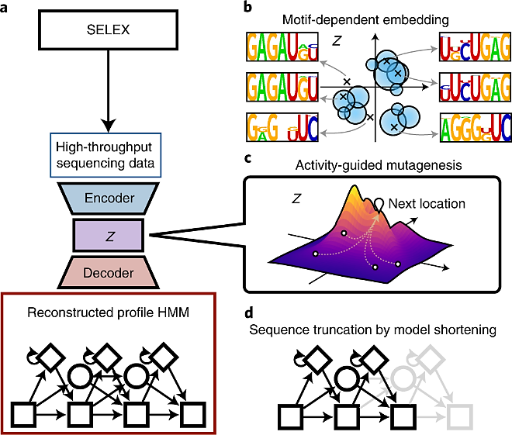
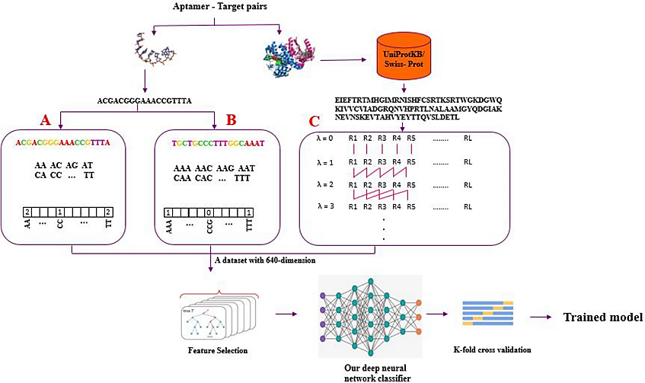
Implementation and overall progress
Task 2.1: Identification, synthesis, and evaluation of Aptamers for AD protein biomarkers
Generative aptamer discovery using RaptGen.
A schematic overview of the training module of AptaNet.

Slide 16
Implementation and overall progress
Task 2.1: Identification, synthesis, and evaluation of Aptamers for AD protein biomarkers
Synthesis of up to 5 DNA aptamers per target, with the most robust properties and evaluation for their binding properties and specificity of chosen aptamers.

Slide 17

Implementation and overall progress
Task 2.2: Optimization and functionalization of aptamers
M13
Evaluation and optimization of aptamers’ size. Truncated variants of aptamers will be designed on the basis of their predicted secondary structure, chemically synthesised, and studied with respect to their binding properties (SPR or BLI).
Aptamers corresponding to the minimal oligonucleotide displaying the properties of the parent aptamer will be further elaborated while one of the 2 fixed flanks of the full-length aptamer may serve for immobilization purposes on MNPs. Such modified aptamers will be evaluated via SPR or BLI protocol.
These binding properties will be used as features to, along with the structure, train a deep learning model aiding length optimization.

Slide 18
Implementation and overall progress
Task 2.3: Synthesis and characterization of magnetic nanoparticles as carriers and enablers
Synthesis of Magnetite (Fe₃O₄) MNPs of different sizes
Characterization structurally, morphologically, and magnetically (TEM, XRD, VSM)
These hybrid MNPs will be conjugated with the aptamers (1↔1) following established protocols and finally purified to be used within the platform.

Slide 19


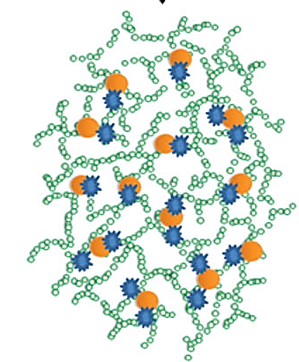

Identity, timeline and overall progress
Task 2.3: Synthesis and characterization of magnetic nanoparticles as carriers and enablers
Fe₃O₄
Ø 15/15/30 nm
Z-potential: -80 mV
Au
Au
Ø 20/4 nm
Z-potential: 0 mV
Fe₃O₄
Ø 10 nm
Z-potential: -50 mV

Slide 20
Identity, timeline and overall progress
Task 2.4: Immobilization, Functionalization & Evaluation of Conjugated MNPs/Aptamers/Biomarkers
Immobilization of Aptamers on MNPs
  Aptamers immobilization protocols will be tested to optimize their immobilization efficiency on MNPs depending on the size of the MNP and of the aptamers.
M18
thrombin aptamer for initial testing
two different functionalization alternatives:
-thiolo (SH) aptamer
Thiolo: SH-GGTTGGTGTGGTTGG
- polyAdenylated (pA10) tail
pA10: AAAAAAAAAAGGTTGGTGTGGTTGG

Slide 21
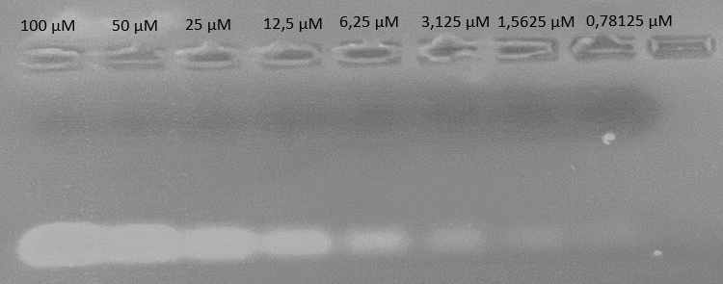
Identity, timeline and overall progress
Task 2.4: Immobilization, Functionalization & Evaluation of Conjugated MNPs/Aptamers/Biomarkers
Immobilization of Aptamers on MNPs
Investigate optimal salinity, pH and Aptamer/Au MNPs ratio for optimizing conjugation
i) Agarose Electrophoresis
ii) Fluorescence analysis
M18
1% Agarose
10 mM HEPES Buffer
Excitation: 525
Emission: 480-540

Slide 22
Identity, timeline and overall progress
Task 2.4: Immobilization, Functionalization & Evaluation of Conjugated MNPs/Aptamers/Biomarkers
Immobilization of Aptamers on MNPs
An increace of salinity up to 90 mM assists binding of pA10 aptamer to NPs
pH levels of 7.5 are currently regarded as the most promising
Study different time intervals between NaCl addition (salt-aging up to 3 days)
Next
-Reference with single core Au NPs
- UV spectroscopy for determining aptamer concentration
-Use biotinylated aptamer to verify bound aptamer on MNPs with streptavidin-HRP and enzymatic reaction based on HRP enzyme
M18

Slide 23
Identity, timeline and overall progress
Task 2.4: Immobilization, Functionalization & Evaluation of Conjugated MNPs/Aptamers/Biomarkers
Functionalization of Conjugated MNPs/Aptamers /Biomarkers
  Various conditions will be applied to optimize the rate of MNPs-Aptamers/biomarkers. This work will be multiplied by the number of biomarkers of our interest. ELISA and electrophoresis methods will be used to quantified conjugated and non conjugated biomarkers and aptamers.
Evaluation of Conjugated MNPs/Aptamers / Biomarkers
  A systematic investigation of the binding capacity of conjugated MNPs/Aptamers with the selected biomarkers in simple and complex solutions will be performed.
M18

Slide 24
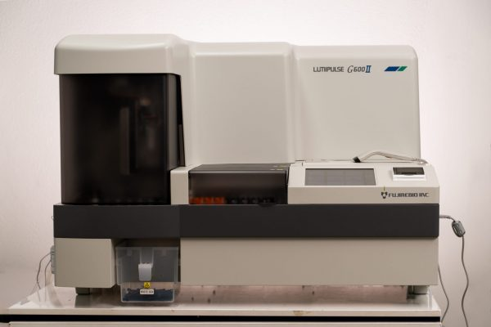
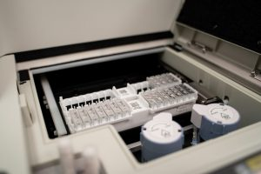
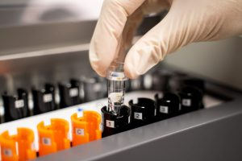
Identity, timeline and overall progress
Task 2.4: Immobilization, Functionalization & Evaluation of Conjugated MNPs/Aptamers/Biomarkers
M18
https://www.fujirebio.com/en/products-solutions/lumipulse-g600ii
• Fully automated benchtop immunological analyzer for biomarker determination (60 tests per hour).
• Biomarkers: β-Amyloid 1-40, β-Amyloid 1-42, pTau 181, pTau 217, NfL, ApoE4 and Pan-ApoE.
• easy handling for clinical samples. Cost: 50 euro/sample

Slide 25
Identity, timeline and overall progress
Objectives
Conjugated MNPs/Aptamers Design, Synthesis, and Selection
Selection of specimens based on evaluation of (D2.1) immobilization data and (D2.2) binding capacity of the aptamers with specific biomarkers.
Conjugated MNPs/Aptamers Binding to AD Biomarkers evaluation
Evaluation results of the binding affinity and specificity (D2.3) to AD biomarkers after optimised functionalisation (D2.4).
24
12
18
30

Slide 26
WP2 Biomarkers binding and quantitative analysis
Issues for discussion

Slide 27
WP2– Key Point Indicators
Task | Indicator | Target | Lead Partner | Deadline | Checkpoint
2.1 | Protein Biomarkers for AD analyzed | >=7 | NOVA | M24 | M12
2.1 | DNA aptamers per target synthesized and evaluated for their binding properties and specificity of chosen aptamers | up to 5 per biomarker | total 25 | NOVA | M24 | M12

Slide 28

To Discuss
Nanoparticles
Form Preference: Nanoparticles in a solution or powder form?
Quantity Expectations: How many milligrams of nanoparticles?
Additional Comments: Specific features of nanoparticles.
Aptamers
Status of ongoing characterization and synthesis of aptamers.
Design and standardization of aptamers for specific biomarker detection.
Provision of aptamers with either thiol tail group or polyA tail group at one end and biotin at the other end to initiate experiments on conjugation and response to peptides of interest.

Slide 29
















Slide 30
WP2 Biomarkers binding and quantitative analysis
Questions & Answers

