Slide 1
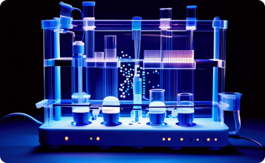
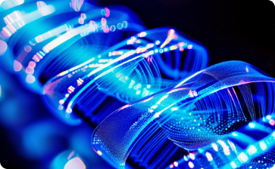
Supple Graphene Bio-Platform for point-of-care early detection and monitoring of Alzheimer’s Disease
M. Angelakeris
Professor | School of Physics | Aristotle University
Thessaloniki | 54124 | Greece
2023-2027
Supple Graphene Bio-Platform for point-of-care early detection and monitoring of Alzheimer’s Disease
https://2d-biopad.eu/

Slide 2
Supple Graphene Bio-Platform for point-of-care early detection and monitoring of Alzheimer’s Disease
https://2d-biopad.eu/
2023-2027

Slide 3
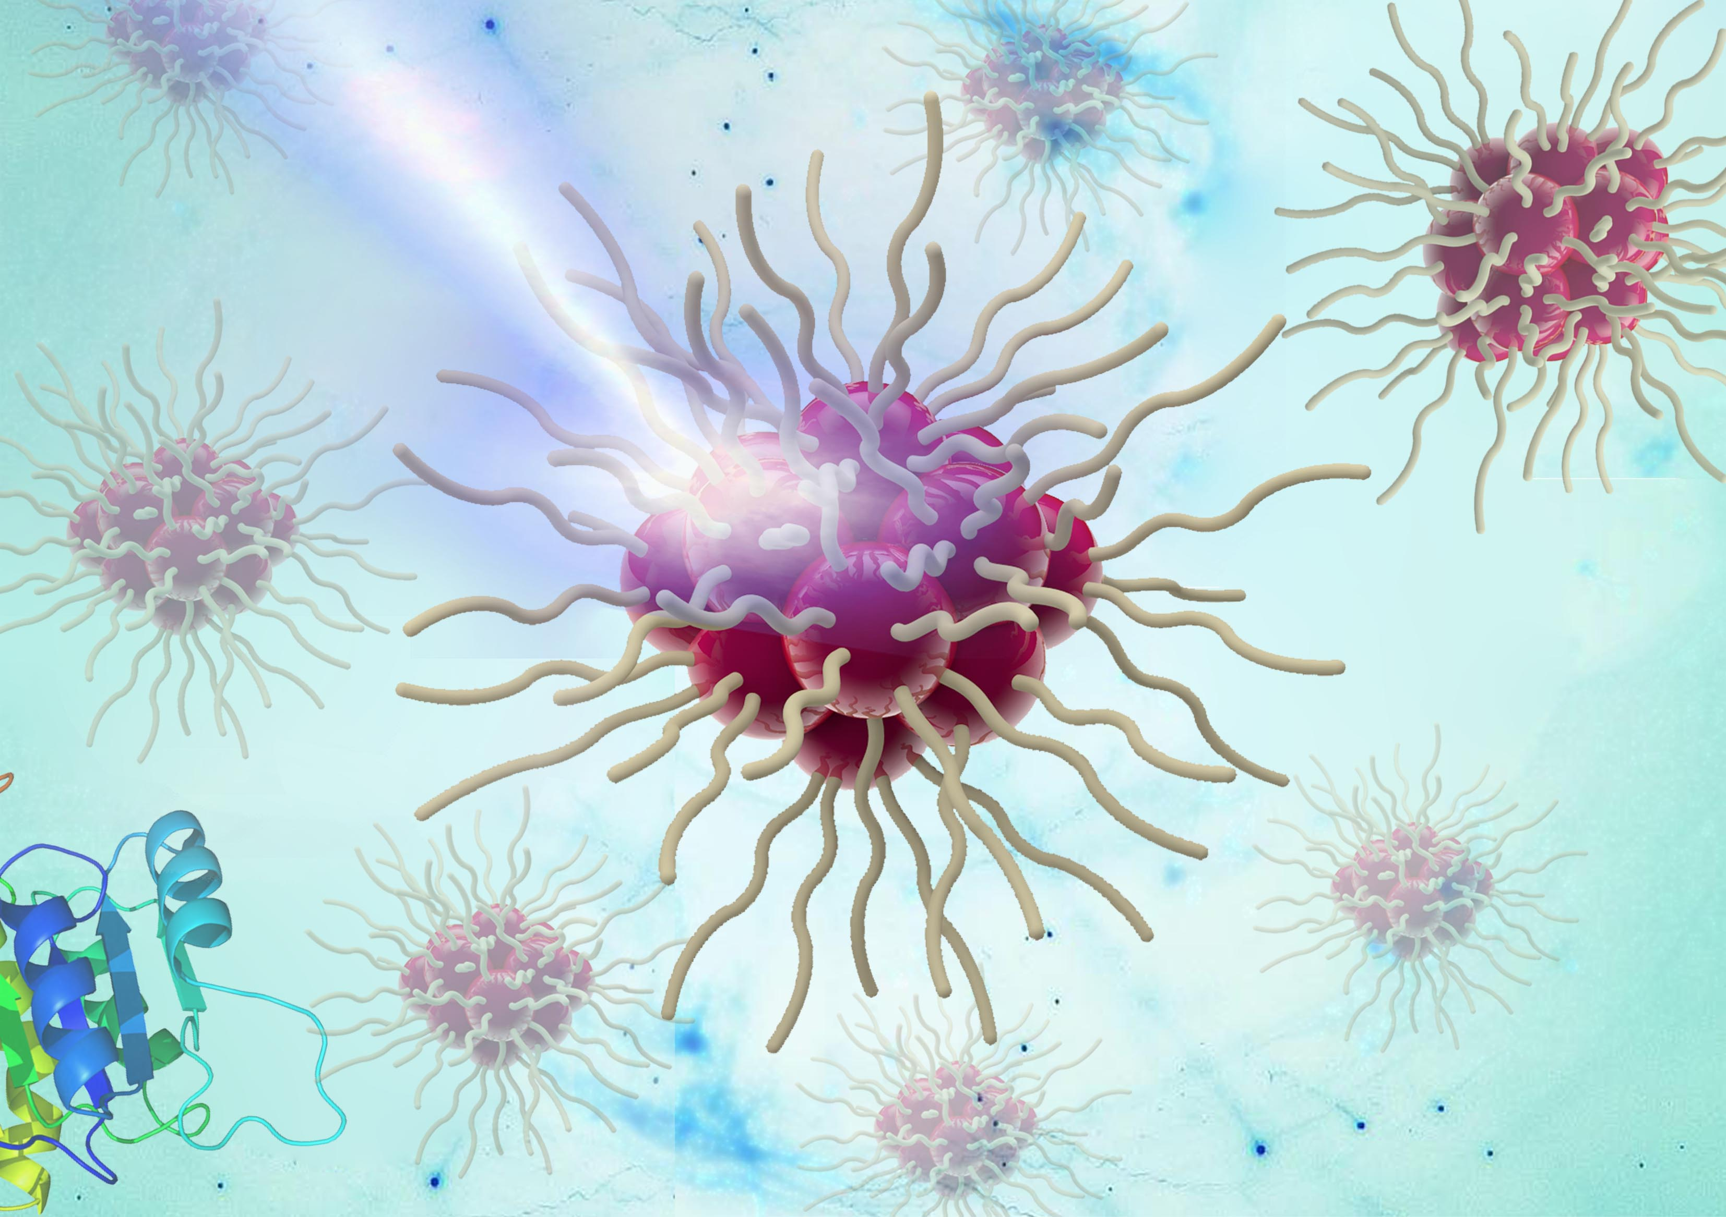
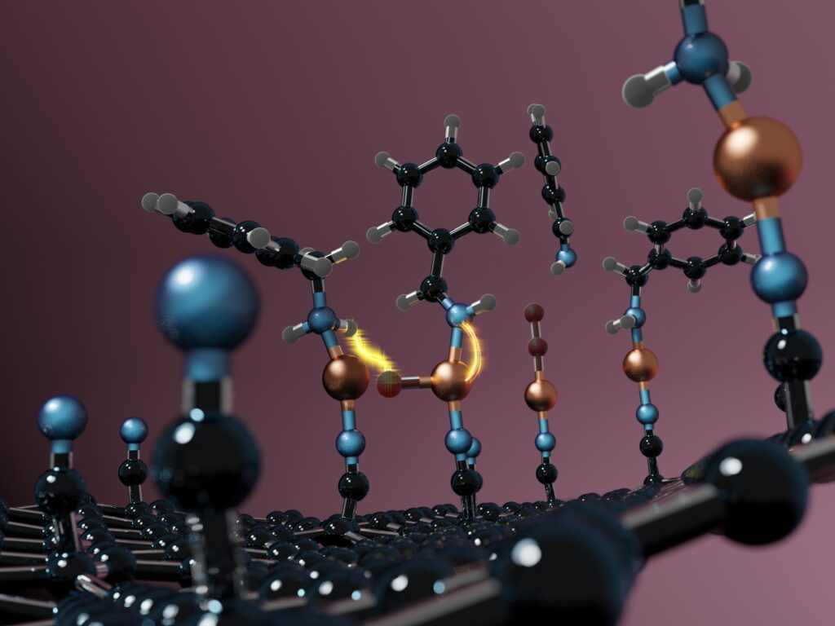
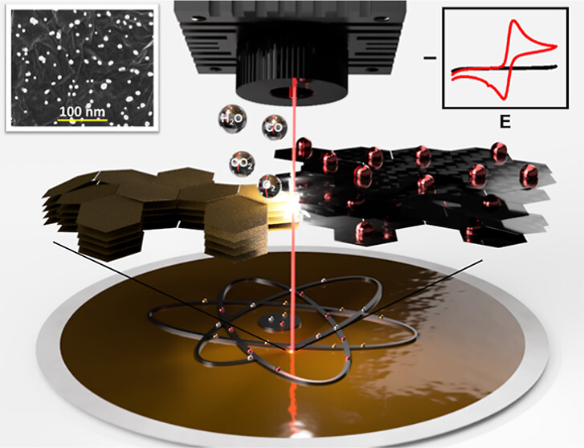
Supple Graphene Bio-Platform for point-of-care early detection and monitoring of Alzheimer’s Disease
https://2d-biopad.eu/
2023-2027
The Players
Biomarkers
Clinicians /
HCPs
Nanoparticles
Biomarkers
Graphene
chemistry
Aptamers
Bio-probes
Electrochemical
Graphene-based
sensors
Regulatory &
Clinical Compliance
GFETs
PoC Digital IVDs
Artificial
Intelligence
Dissemination &
Exploitation

Slide 4
The Concept 01/02
https://2d-biopad.eu/
1
A paper-based substrate with a sampling pad, detection zone and absorbent pad, the blood sample without any pre-treatment is deposited on the paper.
2
The aptamer embedded in the pad (labelled with a redox molecule and magnetic nanoparticle) binds to the biomarker and a conformational change occurs, revealing the hidden single-stranded DNA.
This DNA strand is complementary to that found on the graphene electrodes, so only the aptamer bound to the biomarker will bind to the electrode.
The redox marker produces an electrochemical response when an electrical potential is applied, which is proportional to the concentration of biomarkers present in the sample.
3
4
The unchanged aptamers continue on their path to the absorbent pad avoiding non-specific interactions.

Slide 5
The Concept 02/02
https://2d-biopad.eu/
6
5
5
the 2D-BioPAD cassette/device is then connected to an external device to induce and control the magnetic field along the strip, and a potentiostat for the electrochemical measurements.
and finally, a smartphone with a dedicated app for controlling the device and extracting the measurements, offering also the needed visualisation for the end-user.

Slide 6
WP2 Biomarkers binding and quantitative analysis
https://2d-biopad.eu/
Tasks
Task 2.1: M4-M24:
Identification, synthesis, and evaluation of Aptamers for AD protein biomarkers
Task 2.3: M4-M24:
Synthesis and characterization of magnetic nanoparticles as carriers and enablers
Deliverables
M12: D2.1:
Conjugated MNPs/Aptamers Design, Synthesis and Selection Version1
M24: D2.2:
Conjugated MNPs/Aptamers Design, Synthesis, and Selection, Version 2
Task 2.2: M13-M24:
Optimization and functionalization of aptamers
Task 2.4: M18-M30:
Immobilization, Functionalization & Evaluation of Conjugated MNPs/Aptamers/Biomarkers
M18: D2.3:
Conjugated MNPs/Aptamers Binding to AD Biomarkers evaluation, Version 1
M30: D2.4:
Conjugated MNPs/Aptamers Binding to AD Biomarkers evaluation, Version 2

Slide 7
WP2 Biomarkers binding and quantitative analysis
Biomarkers & Aptamers & NPs
Aptamers are short single-chain nucleic acids which can bind to specific biomarkers of AD with high affinity and specificity for their quantitative detection.
The selection of magnetically responsive nanoparticles is based on the facile tuning under adequate external magnetic fields to be exploited to facilitate sample purification and avoid non-specific signals, as well as to act as flow control at different stages of the bioassay.
Electrochemical sensing, i.e. electrical conductivity, will be achieved by NPs composed of a gold and magnetite. These hybrid NPs will be conjugated with the aptamers which will bind with the specific AD biomarkers.

Slide 8
WP2 Biomarkers binding and quantitative analysis
https://2d-biopad.eu/
1
Aptamer Synthesis
Chemically synthesize the aptamer sequence with desired modifications.
2
Nanoparticle Synthesis
Produce nanoparticles of uniform size and shape.
Conjugation
3
Attach the aptamer to the gold nanoparticle surface through covalent or non-covalent interactions.
Binding
4
Binding to specific AD biomarkers by well established cross-linking methodologies for DNA sequences immobilization.

Slide 9
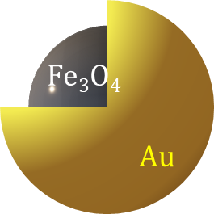
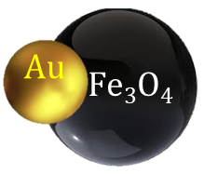
Task 2.3- Synthesis and characterization of magnetic nanoparticles as carriers and enablers
Synthesis and Characterization of Magnetite/Au NPs of different sizes
The size of the MNPs is directly reflected to their magnetic response and in turn their interaction with external magnetic fields while may affect specifically and selectively the aptamer immobilization.
https://2d-biopad.eu/
Gold-magnetite hybrid nanostructures in aqueous media
Synthesis of magnetite magnetic nanoparticles (MNPs) and their decoration with gold (Au-MNPs).¹
2-stage aqueous coprecipation method for core (magnetite)/Shell (Gold) nanoparticles.²
Partial oxidation of the Fe(II) precursor using hydrogen peroxide in the presence of preformed gold nanoparticles dispersed in the reaction medium.³
¹https://doi.org/10.1016/j.colsurfa.2023.131661
²https://doi.org/10.1016/j.snb.2012.01.040)
³https://doi.org/10.3390/magnetochemistry8120185

Slide 10
Task 2. 1: Identification, synthesis, and evaluation of Aptamers for AD protein biomarkers
Aβ-42, Αβ-40, Tau-p231, GFAP NFL
https://2d-biopad.eu/
The reported aptamers against different AD biomarkers need to be checked on various parameters to get a comprehensive understanding of their specificity, cross-reactivity and detection limits.
Currently, the required aptamers are sought by NovapTech SELEX procedure, employing proprietary random oligonucleotide libraries and AI techniques by CeADAR, UCD.
AI: Identification of aptamers and evaluation of their binding affinity to AD protein biomarkers.¹
Literature search to identify, compare, and assess advanced computational methodologies used in aptamer binding research, including MLPD , RaptGen , AptaNet , APIPred , AptaBERT , AptaTrans , and Apta-MCTS (Monte-Carlo Tree Search).
These methodologies span a broad spectrum of techniques, from experimental approaches enhanced by machine learning to state-of-the-art transformer-based models designed for predicting and generating high-affinity aptamer sequences.
Need to narrow down how to translate the indicative aptamers to contribute to a better experimental development, following literature model metrics. Alternative protein sequences to be examined.
¹Shin I. et al. AptaTrans: a deep neural network for predicting aptamer‑protein interaction using pretrained encoders BMC Bioinformatics 24:447 (2023).

Slide 11
Task 2. 1: Identification, synthesis, and evaluation of Aptamers for AD protein biomarkers
Aβ-42, Αβ-40, Tau-p231, GFAP, NFL
https://2d-biopad.eu/
GFAP: Selection and bio-informatic analysis of the selected pools are completed.
Selection carried out in three parallel branches; each one branch represents a condition using an aptamer library. 10 selection rounds performed, quality and quantity of pools satisfactory and positive.
Pools were well and progressively enriched under the applied selection pressure.
The motif prediction analysis of evolved pools (Next Generation Sequencing analysis) indicated that the most represented motifs were G-repeats. Further the evolutionary profile was also studied by clusterization and secondary structure prediction.
Representative sequences selected for further biophysical characterization using SPR and BLI.
Two new selections are also currently under progress for this biomarker using different libraries and procedures. Antibodies are also commercially available against GFAP and are evaluated as an alternative

Slide 12
Task 2. 1: Identification, synthesis, and evaluation of Aptamers for AD protein biomarkers
Aβ-42, Αβ-40, Tau-p231, GFAP NFL
https://2d-biopad.eu/
NFL: Selection and sequencing for NF-L are completed and the NGS data obtained is being analysed to obtain information about motifs, clusters and secondary structure.
Selection was carried out in four branches using two different aptamer libraries.
Quality parameters such as, pool PCR amplification, single-stranded DNA generation were found to be satisfactory.
After NGS analysis, representative sequences will be synthesized for biophysical characterization.
A new selection is also currently under progress for this biomarker using different libraries and procedures. Antibodies are also commercially available against NFL and are evaluated as an alternative

Slide 13
Task 2. 1: Identification, synthesis, and evaluation of Aptamers for AD protein biomarkers
Aβ-42, Αβ-40, Tau-p231, GFAP NFL
https://2d-biopad.eu/
Tau: Commercial availability issues with the target. The required quantity and desired form of protein is not available commercially. The desired form is available with certain suppliers mentioned below:
GENEMEDI (GMP-h-p-tau231-Ag02) where the price is $28000 per mg and one branch of aptamer selection and characterization could consume around 200-300 μg of protein making it hard to visualise.
pTau217 is also available as standard protein with ELISA based detection kits. These kits contain only a few picograms of standard protein and it as well, will not be sufficient for aptamer selection. The suppliers of ELISA kits include Quanterix®, ThermoFisher Scientific, Fujirebio, etc.
Alternative options to be explored to suffice the required pTau217 amount.
GeneMedi | Antibodies / Antigen list of reagents for Phosphorylated Tau 217
Chinese Biotech - SINOBIO | List of recombinant proteins: 1, 2, Antibodies
Biolegend | Tau 441
GeneCust

Slide 14
Task 2. 1: Identification, synthesis, and evaluation of Aptamers for AD protein biomarkers
Aβ-42, Αβ-40, Tau-p231, GFAP NFL
NovapTech
https://2d-biopad.eu/
Aß40 and Aß42 peptides:
Literature aptamers’ binding was inconclusive.*
New selection was started against both peptides which unfortunately did not show any enrichment and did not yield aptamer candidates.
Plan to launch new selection to maintain the structure/form of these peptides.
Other options of Commercially Available Aβ
*Aβ peptides purchased twice from Anaspec
The problem is to keep the Aβ peptides in a stable form throughout the selection process.
The peptides aggregate quickly.

Slide 15
What follows is
aptamer characterization, and individual design optimization (size, buffer, ionic strength, pH, etc.
Task 2.2: Optimization and functionalization of aptamers
https://2d-biopad.eu/
DNA aptamer length affects its immobilization and cost. Specifically, the longer the aptamer,
the lower the immobilization effectiveness might be.
These properties will be used as features to, along with the structure, train a deep learning model aiding length optimization.
Task 2.4: Immobilization, Functionalization & Evaluation of Conjugated MNPs/Aptamers/Biomarkers
Well established cross-linking methodologies for DNA sequences immobilization on MNPs
Systematic investigation of the binding capacity of conjugated MNPs/Aptamers with the selected biomarkers in simple and complex solutions (artificial CSF and plasma)
To validate the detection of the selected biomarkers with higher specificity and sensitivity
Concentrations of amyloid beta are ~10-fold lower in plasma than in CSF, whereas the total protein content in the plasma is 10-fold higher.

