Slide 1
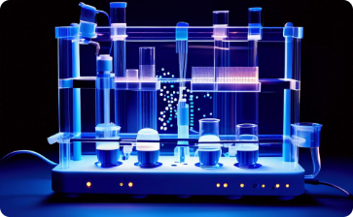

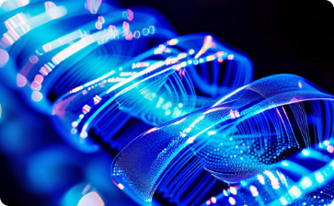

MNPs progress and conjugation with AD aptamers
WP2 Biomarkers binding and quantitative analysis
M. Angelakeris
Professor | School of Physics | Aristotle University
Thessaloniki | 54124 | Greece
https://2d-biopad.eu/

Slide 2




WP2 Biomarkers binding and quantitative analysis
https://2d-biopad.eu/
Nanoparticle Synthesis
1
Produce nanoparticles of uniform size and shape.
Aptamer Synthesis
2
Chemically synthesize the aptamer sequence with desired modifications.
Conjugation
3
Attach the aptamer to the gold nanoparticle surface through covalent or non-covalent interactions.
Binding
4
Binding to specific AD biomarkers by well established cross-linking methodologies for DNA sequences immobilization.

Slide 3
MNPs progress and conjugation with AD aptamers
WP2 Biomarkers binding and quantitative analysis
https://2d-biopad.eu/
Tasks
Task 2.1: M4-M24:
Identification, synthesis, and evaluation of Aptamers for AD protein biomarkers
Task 2.3: M4-M24:
Synthesis and characterization of magnetic nanoparticles as carriers and enablers
Deliverables
M12: D2.1:
Conjugated MNPs/Aptamers Design, Synthesis and Selection Version1
M24: D2.2:
Conjugated MNPs/Aptamers Design, Synthesis, and Selection, Version 2
Task 2.2: M13-M24:
Optimization and functionalization of aptamers
Task 2.4: M18-M30:
Immobilization, Functionalization & Evaluation of Conjugated MNPs/Aptamers/Biomarkers
M18: D2.3:
Conjugated MNPs/Aptamers Binding to AD Biomarkers evaluation, Version 1
M30: D2.4:
Conjugated MNPs/Aptamers Binding to AD Biomarkers evaluation, Version 2

Slide 4
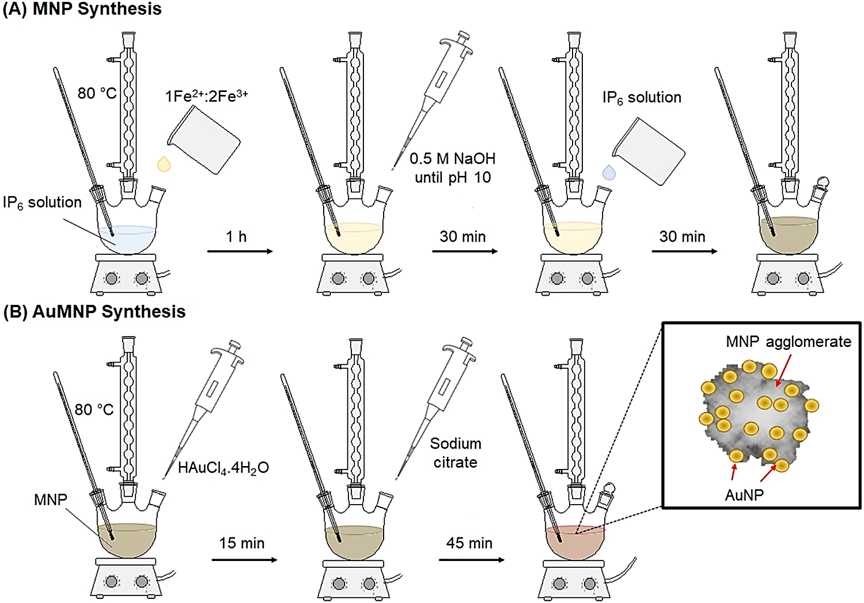
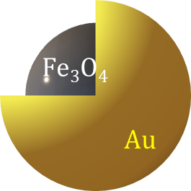
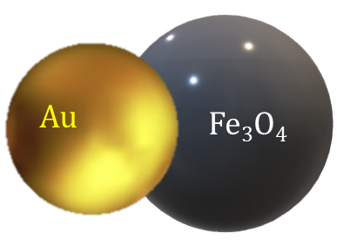
Task 2.3- Synthesis and characterization of magnetic nanoparticles as carriers and enablers: M4-M24
Synthesis and Characterization of Au/Fe₃O₄ NPs of different sizes
The size of the MNPs is directly reflected to their magnetic response and in turn their interaction with external magnetic fields while may affect specifically and selectively the aptamer immobilization.
https://2d-biopad.eu/
Gold-magnetite hybrid nanostructures in aqueous media
Synthesis of magnetite magnetic nanoparticles (MNPs) and their decoration with gold (Au-MNPs).¹
2-stage aqueous co-precipation method for core (magnetite)/Shell (Gold) nanoparticles.²
Partial oxidation of the Fe(II) precursor using hydrogen peroxide in the presence of preformed gold nanoparticles dispersed in the reaction medium.³
¹https://doi.org/10.1016/j.colsurfa.2023.131661
²https://doi.org/10.1016/j.snb.2012.01.040)
³https://doi.org/10.3390/magnetochemistry8120185

Slide 5
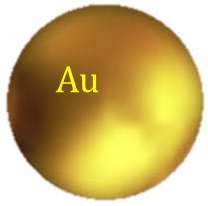
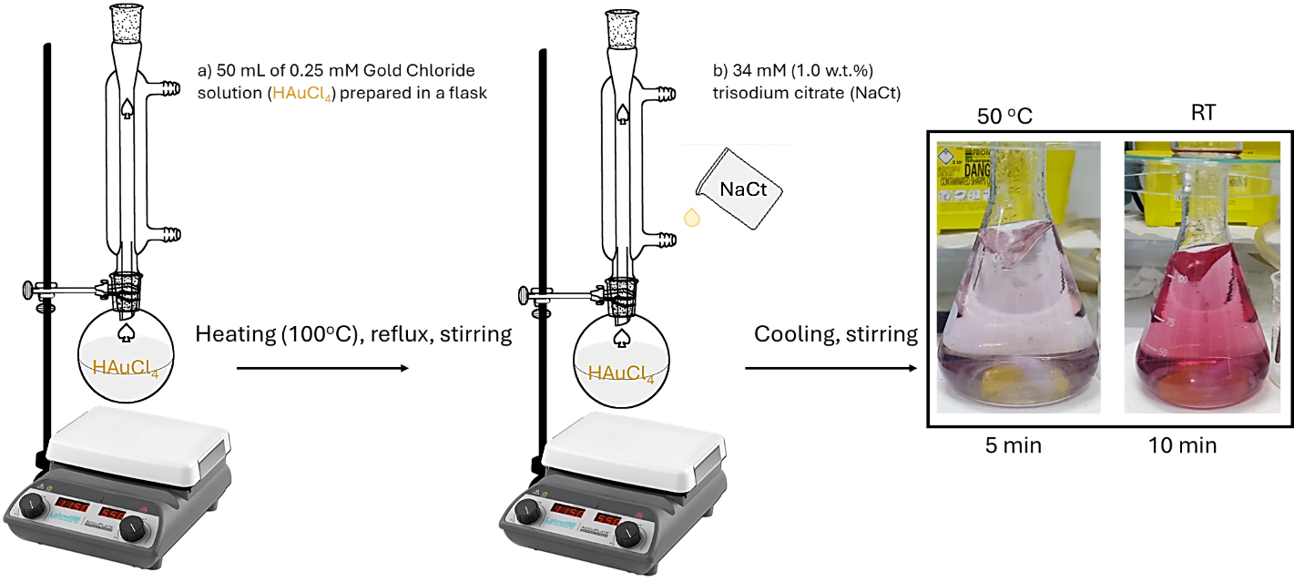
Task 2.3- Synthesis and characterization of magnetic nanoparticles as carriers and enablers: M4-M24
Synthesis and Characterization of Au/Fe₃O₄ MNPs
https://2d-biopad.eu/
Au Reference
50 nm
This synthesis is used to fabricate the reference sample of Au-NPs
final Au nanoparticles product, with a wine-red color indicating the presence of non-aggregated Au-NPs at room temperature, compared with the purple color of the dispersion at 50°C.
Schematic illustration of the synthetic procedure: This process involves heating an HAuCl₄ solution, followed by the rapid injection of NaCl solution.
¹ J. Dong et al. "Synthesis of precision gold nanoparticles using Turkevich method KONA Powder and Particle Journal 37 (2020): 224-232, https://doi.org/10.14356/kona.2020011)

Slide 6
Task 2.3- Synthesis and characterization of magnetic nanoparticles as carriers and enablers: M4-M24
Synthesis and Characterization of Au/Fe₃O₄ MNPs
https://2d-biopad.eu/
Au-decorated MNPs
Synthesis of magnetite nanoparticles and their conjugation with gold.
MNPs were synthesized via a coprecipitation method based on a previous work of Miyazaki et al.* with slight modifications from the procedure described by Yang et al.**
illustration of the Au-decorated MNPs
10 nm
*Miyazaki et al. "Gold conjugated-magnetite nanoparticles for magnetic concentration towards reproducibility and repeatability of SERS measurements." Colloids Surf. A: Physicochem. Eng. 671 (2023): 131661, https://doi.org/10.1016/j.colsurfa.2023.131661)
**Yang et al. (T. Yang, et al. Au dotted magnetic network nanostructure and its application for on-site monitoring femtomolar level pesticide, Small 10 (2014) 1325–1331, https://doi.org/10.1002/smll.201302604)

Slide 7
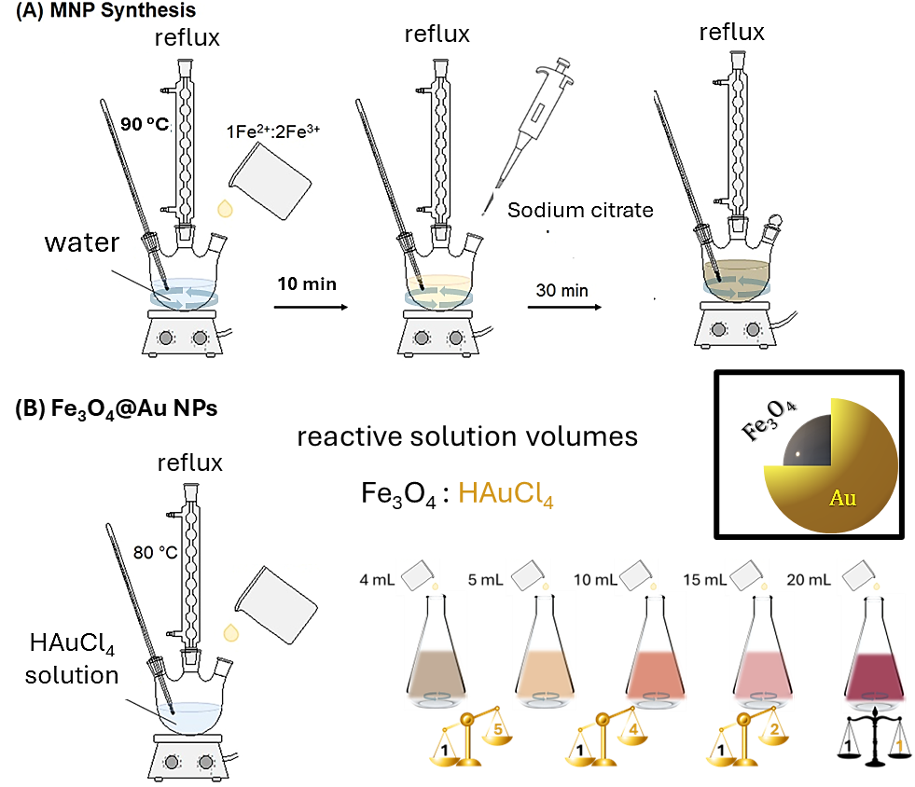
Task 2.3- Synthesis and characterization of magnetic nanoparticles as carriers and enablers: M4-M24
Synthesis and Characterization of Au/Fe₃O₄ MNPs
https://2d-biopad.eu/
Core-Shell-1
2-stage co-precipitation synthesis *
1st Stage: Fe₃O₄ NPs
2nd Stage-Fe₃O₄–Au Core-Shell NPs
Illustration of step-by-step procedure of adding Fe₃O₄ nanoparticle solution to a boiling HAuCl₄ solution, under reflux, in varying volumes, followed by magnetic separation and washing.
15 nm
Schematic representation of the core-shell structure of the resulting nanoparticles, with Fe₃O₄ forming the core and Au forming the shell.
2 nm
*H. Zhou et al. "Ultrasensitive DNA monitoring by Au–Fe₃O₄ nanocomplex." Sensors and Actuators B: Chemical 163.1 (2012): 224-232, https://doi.org/10.1016/j.snb.2012.01.040)

Slide 8
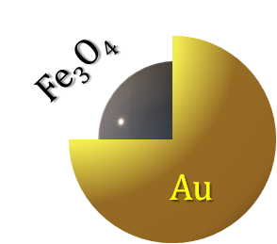
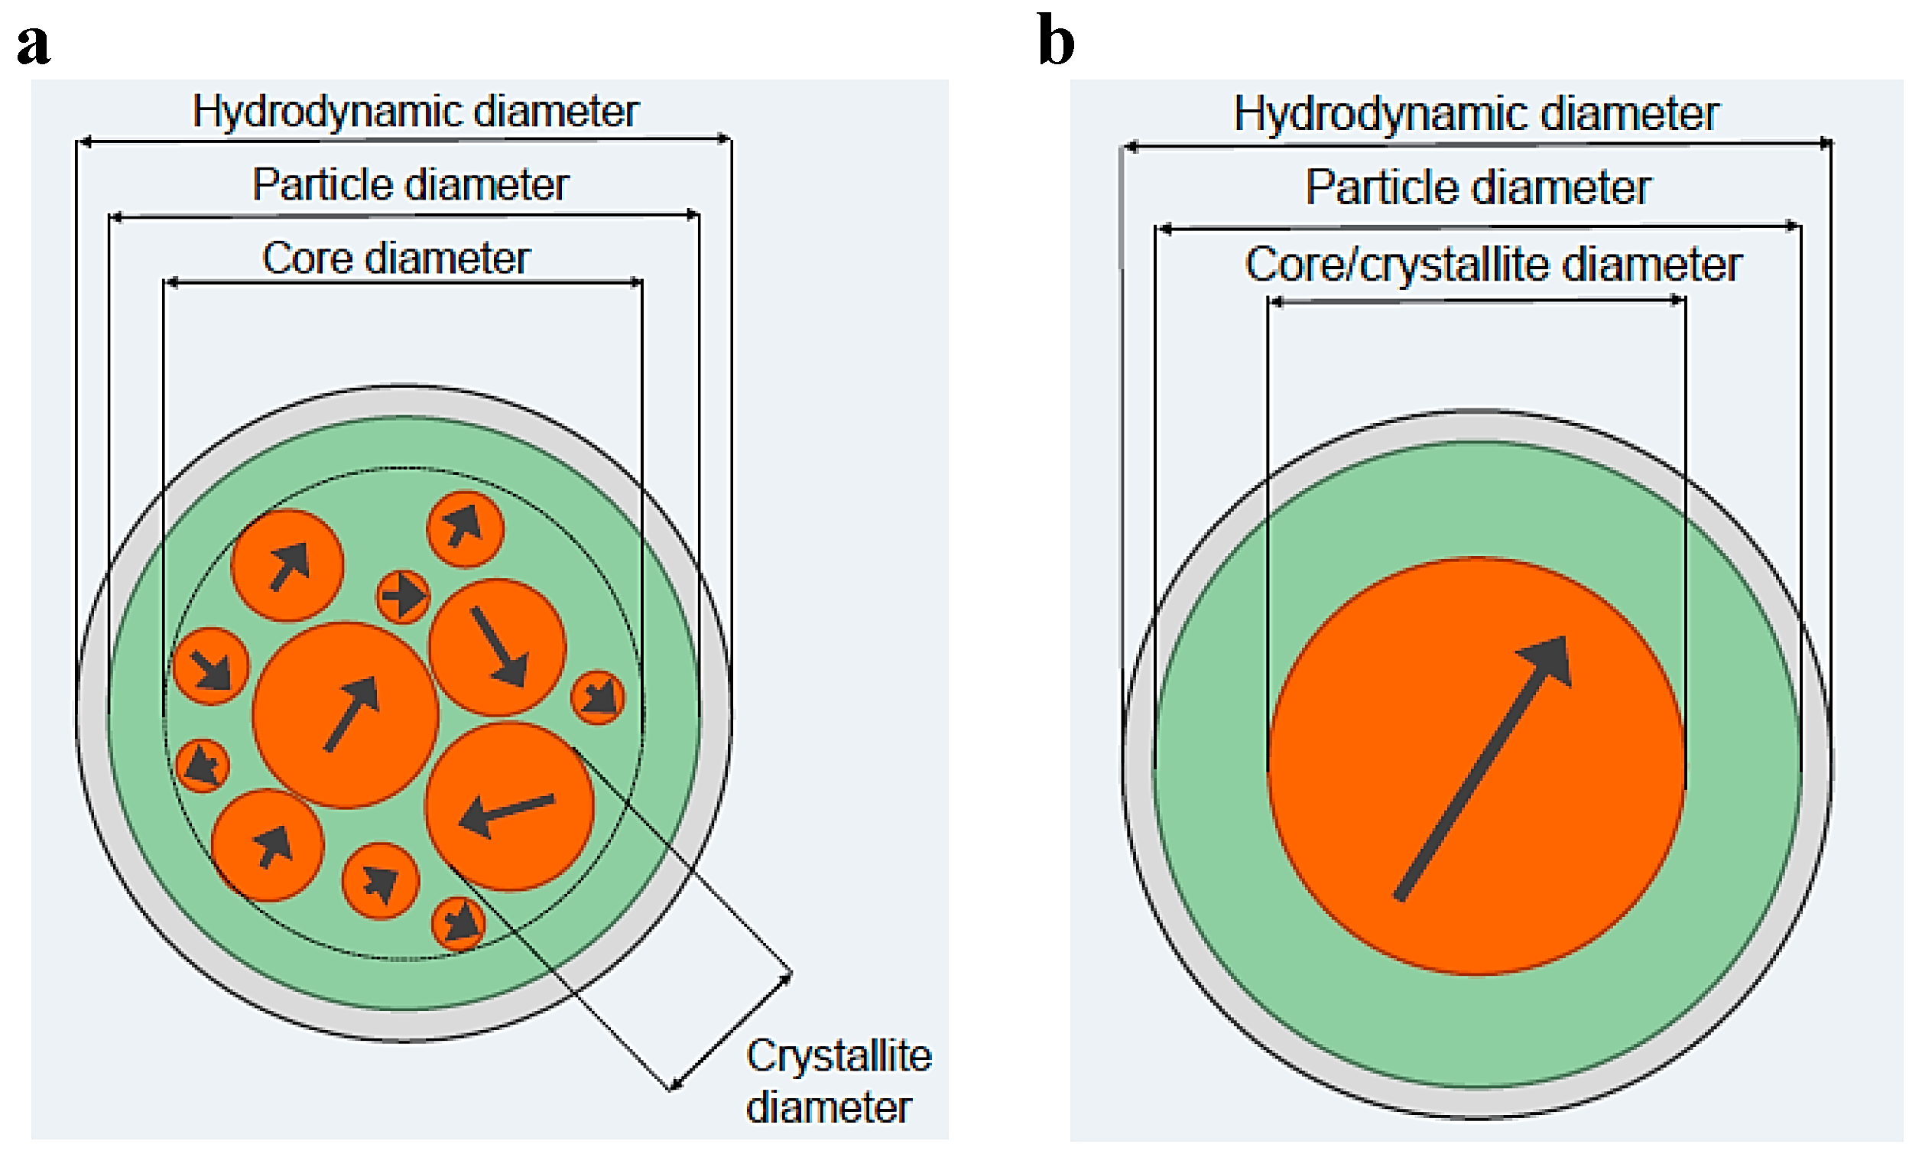
Task 2.3- Synthesis and characterization of magnetic nanoparticles as carriers and enablers: M4-M24
Synthesis and Characterization of Au/Fe₃O₄ MNPs
Core-Shell-2
Synthesis of Citrate-Stabilized and Gold-Coated MNPs*
https://2d-biopad.eu/
To achieve enhanced long-term stability and size control over Au-MNPNs, sodium citrate was used in the second stage of synthesis to further stabilize the particles, creating Cit-Au-SPIONs.
1. Citrate-Stabilized SPIONs (Cit-SPIONs)
Iron Solution: Dissolve Fe(II) and Fe(III) salts in H₂O (13.2 mg Fe/mL) and deoxygenize with argon.
NH₃ Injection: Add 25% NH₃ (aq) to form SPION dispersion (black), stir for 10 min.
Citrate Addition: Add sodium citrate (293.3 mg/mL), stir at 90°C for 30 min.
Dialysis: Dialyze in H₂O for 6 hours, filter, and store at 4°C.
2. Gold-Coated SPIONs (Au-SPIONs)
Cit-SPION Preparation: Adjust iron concentration, deoxygenize with argon.
Gold Coating: Heat to 110°C, add HAuCl₄ solution. Color changes to deep red (15 min stirring).
Cool and Store: Cool to room temperature.
3. Citrate-Stabilized Gold-Coated SPIONs (Cit-Au-SPIONs)
After gold coating, add sodium citrate, stir briefly, and cool. Result: Cit-Au-SPIONs (enhanced stability).
D_{H}=152 nm
¹ R. Stein et al., Synthesis and Characterization of Citrate-Stabilized Gold-Coated Superparamagnetic Iron Oxide Nanoparticles for Biomedical Applications, Molecules 2020, 25(19), 4425; https://doi.org/10.3390/molecules25194425

Slide 9
Task 2.3- Synthesis and characterization of magnetic nanoparticles as carriers and enablers: M4-M24
Synthesis and Characterization of Au/Fe₃O₄ MNPs
https://2d-biopad.eu/
Core-Shell-3
The main difference is the use of pre-synthesized Au NPs instead of directly reducing Au onto Fe₃O₄. Sodium citrate acts as a reducing agent for Au in this process.
30 nm
9 nm
Three-Step Procedure*
Synthesis of Fe₃O₄ NPs:
  Deoxygenated NaOH and H₂O₂ are sequentially added to FeSO₄·7H₂O under continuous N₂ bubbling, allowing for controlled concentrations.
Synthesis of Au NPs:
  Follows the Turkevich method, using sodium citrate as a reducing agent, with the reaction stopped upon observing a ruby-red color.
Synthesis of Au-Fe₃O₄ MNPs:
  Pre-synthesized Au NPs are incorporated into the Fe₃O₄ synthesis, replacing water, which distinguishes this process from earlier methods where Au was deposited directly.
*R. González Ochea et al., A partial oxidation-based approach to the synthesis of gold-magnetite hybrid nanostructures, Scientific Reports volume 14, 7352 (2024) https://www.nature.com/articles/s41598-024-58145-0

Slide 10
Task 2.3- Synthesis and characterization of magnetic nanoparticles as carriers and enablers: M4-M24
Synthesis and Characterization of Au/Fe₃O₄ MNPs
Janus Particles*
30 nm
https://2d-biopad.eu/
3 nm
Preparation of Reaction Mixture:
  Solvent and Surfactants: Mix 100 mL of 1-octadecene, 10 mL of oleic acid, 10 mL of oleylamine, and 6.44 g of 1,2-hexadecanediol in a three-neck round-bottom flask under argon. Heat to 120 °C for 20 min.
Injection of Precursors:
  Iron and Gold Sources: Inject 1.5 mL of iron pentacarbonyl and 150 mg of hydrogen tetrachloroaurate (dissolved in 12.5 mL of 1-octadecene and 1.25 mL of oleylamine) into the heated mixture. Heat under reflux at 310 °C for 45 min, then cool to room temperature and air-expose for 1 h.
Isolation of MNPs:
  Precipitation and Drying: Isolate MNPs by adding isopropanol, followed by centrifugation at 6000 rpm for 10 min, and dry under vacuum.
Surface Modification with APTES:
  Amino Group Introduction: Coat MNPs with APTES by adding 100 mL of APTES and 50 μL of acetic acid to 10 mg of MNPs in 10 mL of toluene. Heat to 40 °C and stir overnight. Precipitate using a magnet, wash with deionized water, and redispersed in 9 mL of 0.1M PBS (pH = 8.3).
* A. S. Garanina et al., Bifunctional Magnetite–Gold Nanoparticles for Magneto-Mechanical Actuation and Cancer Cell Destruction, Magnetochemistry 2022, 8(12), 185; https://doi.org/10.3390/magnetochemistry8120185

Slide 11
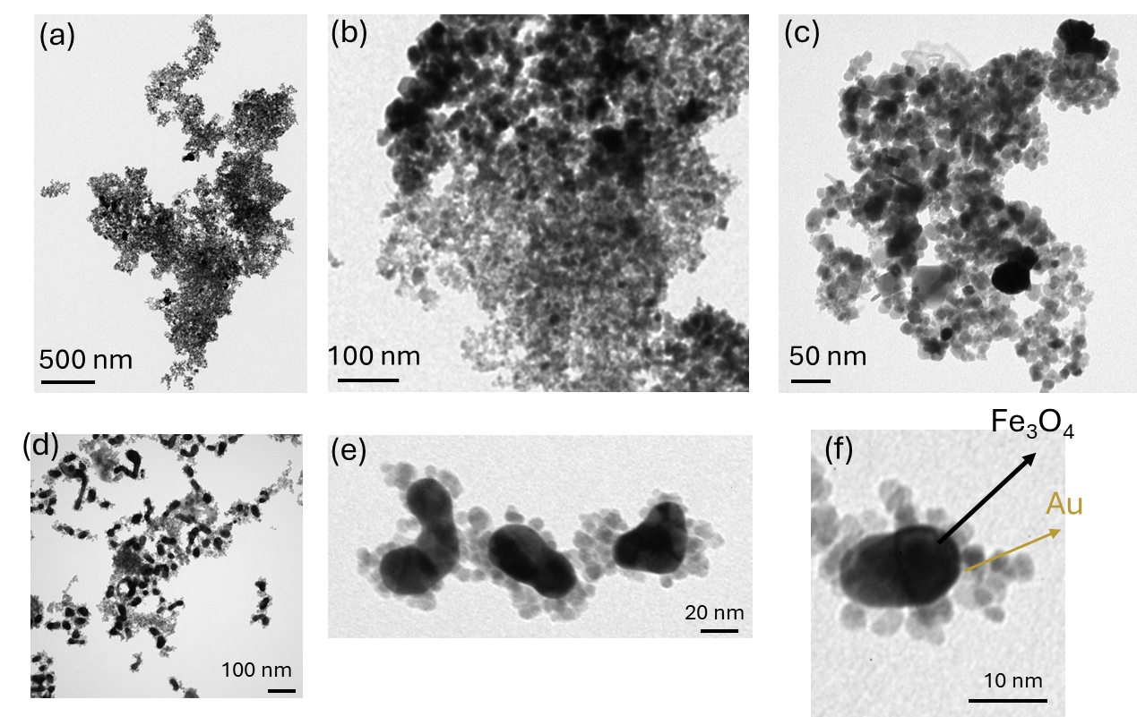
Task 2.3- Synthesis and characterization of magnetic nanoparticles as carriers and enablers: M4-M24
Synthesis and Characterization of Au/Fe₃O₄ MNPs

Slide 12
Task 2.3- Synthesis and characterization of magnetic nanoparticles as carriers and enablers: M4-M24
Synthesis and Characterization of Au/Fe₃O₄ MNPs
https://2d-biopad.eu/
Au-Fe₃O₄ MNPs | H_{c} (mT) | M_{r} (Am²/kg) | M_{s} (Am²/kg)
Au decorated MNPs | 2.5 | 2.5 | 39
Core shell-1 | 3 | 3.5 | 32
Core shell-2 | 47 | 14 | 24
Core shell-3 | 4 | 0.1 | 8
Janus Particles | 6.5 | 0.4 | 4.5

Slide 13
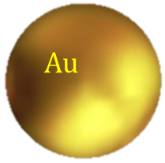

Task 2.3- Synthesis and characterization of magnetic nanoparticles as carriers and enablers: M4-M24
Synthesis and Characterization of Au/Fe₃O₄ MNPs
https://2d-biopad.eu/
Sample Description | Code Name | Reference |  |  | Structure & Morphology |  | Hydrodynamic Properties (DLS) |  | Magnetic Properties (VSM@RT)
 |  | Mean Size (nm) |  | Ref | XRD | TEM (nm) | D_{H} (nm) | Zeta Potential (mV) | M_{s} (Am²kg⁻¹) | % M_{s} ²
 |  | ΤΕΜ¹ | DLS²
Au Reference-1 | AuFe07 (Au-ref) | 17 ± 2 |  | Dong et al. | ✓ | x | 78 | -64 | - | -
Au Reference-2 | AuFe 08 (GMCP4- Au Part) | 18 ± 3 | 30 | Demirbas et al. | ✓ | x | 31 | 0 | - | -
Au-decorated MNPs | AuFe01 (GMCP1) | 10 ± 2 |  | Miyazaki et al. | ✓ | 10 ± 5 | 1120 | -49 | 39 | 43
Core-Shell-1 | AuFe05 (GMCP2) | 15 ± 2 |  | Hongjian, et al. | ✓ | 12@3 | 76 | -77 | 32 | 36
Core-Shell-2 | AuFe11 (GMCP3) | 15 | 152 | Stein et al. | ✓ | ICN2 | 160 | -70 | 24 | 27
Core-Shell-3 | AuFe15 (GMCP4) | 30 ± 9 |  | Ochea et al. | ✓ | ICN2 | 120 | -60 | 8 | 9
Janus Particles | AuFe06 (DGM) | 21@3 | 251 ± 23 | Garanina et al. | ✓ | ICN2 | 300 | -50 | 5 | 6
TEM Reference
DLS Reference
Fe₃O₄ M_{s}= 91 A m² kg⁻¹
Optimize size/dimensions, morphology and magnetic features

Slide 14
Task 2.4: Immobilization, Functionalization & Evaluation of Conjugated MNPs/Aptamers/Biomarkers
Conjugation of MNPs with Aptamers
https://2d-biopad.eu/
The conjugation with aptamers will be achieved by using well-established cross-linking methodologies, aiming to (i) provide an adaptable and scalable process that can easily be adjusted to different biomarkers
(ii) target a 1 (MNP): 1 (aptamer) ratio to be achieved,
further increasing the selectivity and specificity capability per biomarker.
Conjugation of thiol-modified aptamers on MNPs will be evaluated
with alternative protocols to validate enhanced signal and performance
overnight freezing,
amino-modified aptamers with EDC/NHS chemistry on carboxyl-modified NPs,
APTES/glutaraldehyde chemistry on OH-modified NPs.
FAM-modified fluorescent aptamers will be employed.
After conjugation, aptamers will be detached from the MNPs and quantified with fluorometry.
Determination of electrophoretic mobility on agarose electrophoresis and spectrophotometric analysis.

Slide 15
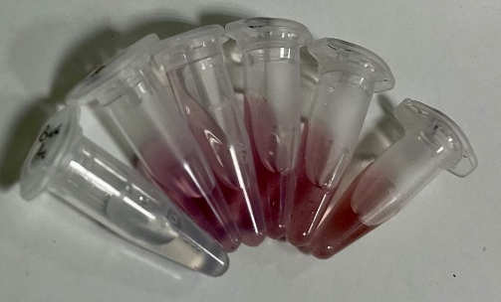
Task 2.4: Immobilization, Functionalization & Evaluation of Conjugated MNPs/Aptamers/Biomarkers
Conjugation of MNPs with Aptamers-Reference
https://2d-biopad.eu/
First testing: conjugate thrombin aptamer with Reference Au NPs.
Thrombin TBA1 (5′-GGTTGGTGTGGTTGG-3′)
Concentration of Au reference NPs was calculated at 2.346 nM.*
              Au NPs are mixed with SH-Aptamer at various aptamer concentrations (0.6 μΜ, 0.9 μΜ, 1.19 μΜ, 2.34 μΜ, 4.69 μΜ) at a final volume of 500 μL in sterile centrifuge tubes.
              Tubes were kept at -20^{ο}C for at least 2 hours and then thawed at room temperature (RT) and centrifuged to discard the unbound aptamers at 13.500 rpm, for 15 min, at 4ºC.
              Aptamer-Au NPs were washed three times with Tris-EDTA buffer, pH 8 (TE), and stored in double distilled water (d.d. H2O), at 4ºC, in the dark.
              Thawing after at least 2 hours of freezing was enough to produce stable aptamer-gold nanoconjugates, with a density 20-30% higher than the one verified by the typical salt-aging method.
Number of thrombin aptamer molecules per AuNP after freeze-thaw treatment, detachment of aptamers with DTT and fluorometric analysis of 6-FAM
* Concentration of AuNPs was calculated spectrophotometrically at 520 nm using a theoretical extinction coefficient (assuming ε= 2.4×10⁸ M⁻¹× cm⁻¹ for a diameter of 12 nm of Au NPs), and with the Lambert-Beer law (A=εcl).

Slide 16
Task 2.4: Immobilization, Functionalization & Evaluation of Conjugated MNPs/Aptamers/Biomarkers
Conjugation of MNPs with Aptamers: 1st run
https://2d-biopad.eu/
Preliminary results with TBA1 aptamer on core-shell NPs
successful conjugation of TBA1 and subsequent positive binding of thrombin.
Freeze-thaw treatment of NPs in the presence of aptamer retained the burgundy-like color of the NPs
Bound aptamer was increased linearly when employing increasing initial aptamer concentration
Agarose (0.8% w/v) electrophoretic analysis of thrombin aptamer-core/shell NPs,
after incubation with 5 μg of thrombin
with 0.45-3.47 of TBA1 aptamer.

Slide 17
Task 2.4: Immobilization, Functionalization & Evaluation of Conjugated MNPs/Aptamers/Biomarkers
Conjugation of MNPs with Aptamers
https://2d-biopad.eu/
Nanoparticles | Aptamer | Target Protein
Gold NPs | TBA1 (5′-GTTGGTGTGGTTGG-3′) | Thrombin
Core Shell NPs | TBA1 (5′-GGTTGGTGTGGTTGG-3′)
Outcomes | Efficient conjugation of TBA1 on nanoparticles Protected complex from precipitation after freezing Stable complex for at least 2 weeks
Conjugation Method | NPs are mixed with SH-Aptamer (0.6 μΜ, 0.9 μΜ, 1.19 μΜ, 2.34 μΜ, 4.69 μΜ) at a final volume of 500 μL. The tubes were kept at -20^{ο}C for at least 2 hours and then thawed at RT. Αptamer-NPs were washed three times with Tris-EDTA buffer, pH 8 (TE) and centrifuged to discard the unbound aptamers at 13500 rpm, for 15 min, at 4ºC
the validation of the conjugation with additional analytical specialized protocols
the application of the protocol in other AD hallmarks under study

Slide 18
Future Steps
Evaluate selected aptamers with known concentrations of the selected biomarkers
in the presence of other similar proteins
and more complex solutions.
Determine the low detection limit (LOD), that these aptamers can detect.*
Issues to consider
Possible redesign and optimization might be needed after the first testing.
Immobilization on NPs might change the binding capacity and specificity of the aptamers.
Our results input for optimization of the final product before the involvement of graphene (WP3).
https://2d-biopad.eu/
* A LOD of 0.25 fM has been achieved with previous biosensors detecting amyloid beta 1-42, thus an equal or better LOD should be achieved.

