Slide 1
State per Biomarker/aptamer provision
GFAP protein: commercially available
FIB012B:AGCCTCGTCTGTTCTCCCTGCGTTGTCATATATTCACTGATGTATAGATCTTGGTTTGGTTGGTCTGGTAGAGATAGTCAGTGGCAGCT
FIB001C:GCTTAGGACGAATTACTCTCTCGCATCATTGGTTTGGTTGGTCTGGTCTGATGCTCCCTACTAACAGCGTTCTGGATGAT
The aptamers are needed to get shortened to refine the design further
NFL protein: commercially available
The sequence has yet to been referred by Novaptech
Already designed and is ready to be delivered to parteners
pTau217 peptide:
SRTPSLP-Tphos-PPTREPKKVA
Τarget to select aptamers against it
Without phosphorylation for control experiment

Slide 2
Tau Phosphorylation sites
***********************************************************************************************************************************************************************
Physiological Phosphorylation:
In a healthy brain, tau protein has about 2-3 molecule of phosphate per molecule of tau protein, which helps control its binding to microtubules and maintain cytoskeletal stability.
Common physiological phosphorylation sites on tau include Ser199, Ser202, Thr205, Ser396, and Ser404. These sites allow tau to function normally by dynamically attaching and detaching from microtubules as needed.
Hyperphosphorylation in Alzheimer’s:
In Alzheimer’s disease, tau becomes excessively phosphorylated at more than 30 serine and threonine residues. This hyperphosphorylation reduces tau’s affinity for microtubules and triggers self-aggregation, leading to the formation of neurofibrillary tangles (NFTs).
Some critical residues associated with tau hyperphosphorylation in Alzheimer’s include:
Ser199, Ser202, Thr205 (early pathological sites)
Thr231, Ser235 (conformational change sites)
Ser262, Ser356 (reduce tau’s affinity for microtubules)
Ser396, Ser404 (often involved in advanced tau aggregation and NFT formation)
Additional residues may also be phosphorylated in disease states, such as Ser422.
10.1016/j.molmed.2009.01.003
10.1038/nrneurol.2015.225

Slide 3
https://doi.org/10.1016/j.molmed.2009.01.003

Slide 4
State per Biomarker/aptamer provision
Αmyloid-β 42:
Fail to conjugate successfully with the aptamer
Stumble upon the aggregation of the full-length peptide
On a quest for shorter peptides (15 -20 aa) covering the C-terminal residues of Aβ42
Αmyloid-β 40:
Fail to conjugate successfully with the aptamer
Stumble upon the aggregation of the full-length peptide
On a quest for shorter peptides (15 -20 aa) covering the C-terminal residues of Aβ40
***************************************************************************************
Outcome:
YS will undertake the synthesis of the necessary peptides.
Delivery of Aβ42 (2-3 mg) and guidance on how to cope with the aggregation.

Slide 5
Some Points for amyloid peptide handling provided in previous communications
Peptides need to be treated upon arrival with HFIP (most commonly) or other similar methodologies (0,1 M NH₃, 35 % acetonitrile/0.1 % TFA, 100 % DMSO) to disaggregate
The solvent is removed by vacuum
The disaggregated peptides are resuspended in DMSO or ammonia solution 0.02% and stored at -80 at a dense concentration in small aliquots
The aliquots should not be frozen again after thawing and should be resuspended at the final desirable concentration in a normal buffer and used immediately
! All forms of amyloid in blood: soluble oligomers or monomers (Αβ40, Αβ24) and possibly protofibrils need to be tested for binding with the candidate aptamers.
https://doi.org/10.1073/pnas.2213157119, https://doi.org/10.1016/j.ab.2018.09.011, https://doi.org/10.3390/ijms22126355
What is our final desired target?

Slide 6
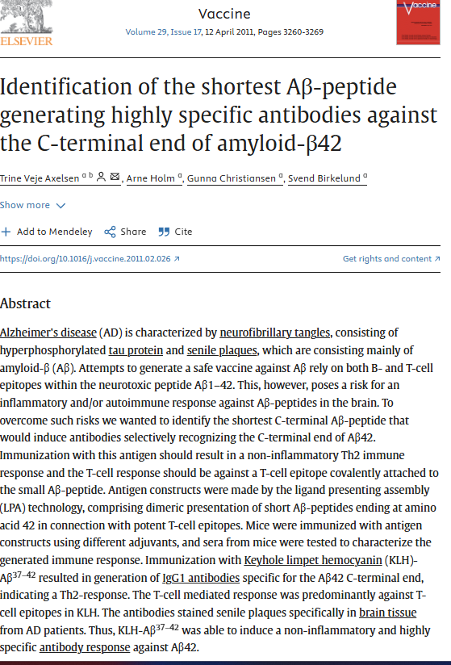
Is this useful?
Immunization with Keyhole limpet hemocyanin (KLH)-Aβ37–42 resulted in generation of IgG1 antibodies specific for the Aβ42 C-terminal end, indicating a Th2-response.

Slide 7
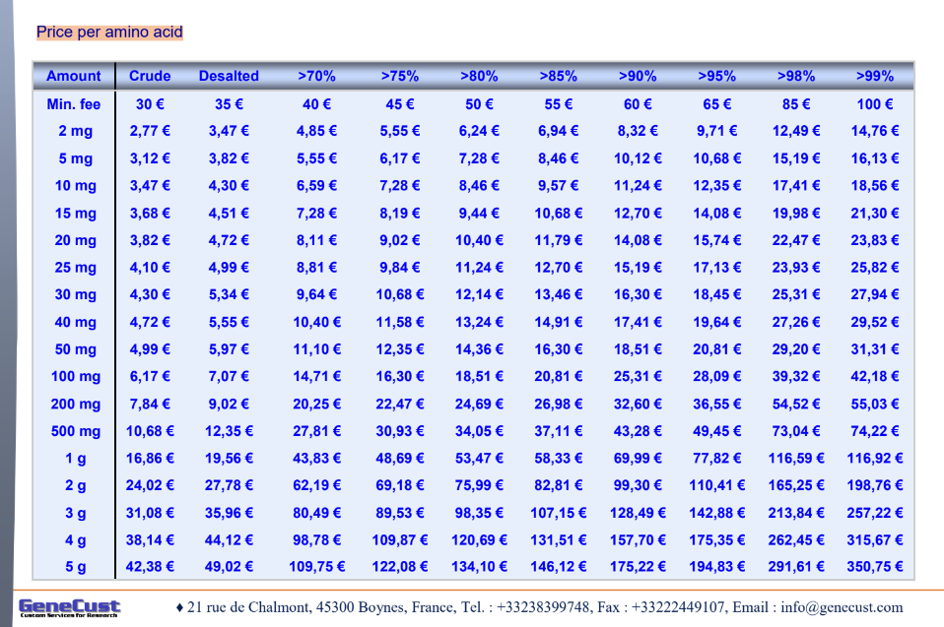
Peptide Synthesis from GeneCust

Slide 8
Aptamer Conjugation on MNPs
We have employed two different types of modified aptamers:
C-terminal polyA10 tail modified aptamers
C-terminal thiolo(SH)-modified aptamers
We have also added a modification with fluorophore (FAM) for easier quantification of the bound/unbound aptamer
We have tested three alternative conjugation methodologies:
Slow “salt-aging” for 1-5 days of aptamers-nanoparticles mixes
Low-pH (3.0) assisted conjugation
Freeze-thaw assisted conjugation (2 hours and overnight freezing)

Slide 9
Salt-aging
Salt (NaCl) is very slowly added to the aptamer-nanoparticles mix (in a timeframe of 1-5 days), to induce binding of the aptamer to the citrate-capped nanoparticles
All attempts failed to retain the nanoparticles dispersity (possibly due to non-stable initial syntheses)
Primal biochemical analyses did not prove significant binding efficiency, and the reproducibility was poor
Too many parameters to define (time, temperature, pH, salt concentration, aptamer concentration, nanoparticles concentrations etc)
Very large excess of aptamer needed for quantitative reaction (according to literature)

Slide 10
Low pH – assisted conjugation
SH-aptamers are mixed with citrate-capped nanoparticles, and an acidic buffer is added to induce quick adsorption of aptamers on gold nanoparticles
This protocol is fast and leads to quantitative conjugation of aptamers on Au NPs (according to literature)
We employed this methodology in initial syntheses (AuFe01-GMCP1, AuFe05-GMCP2) but failed (possibly due to low stability of these nanoparticles)
We repeated this methodology with core-shell MNPs (AuFe11-GMCP3) successfully

Slide 11
Nanoparticles treated with low-pH citrate buffer in the absence of aptamers aggregated as proved by intense color change and sedimentation of the core-shell MNPs (AuFe11-GMCP3) at the bottom of the tube
NO APTAMER
Au NPs (AuFe07, AuFe08) in the presence of aptamers (2 μΜ) retained their initial dispersity and color, indicative of aptamer conjugation on Au NPs (AuFe07, AuFe08) and protection against aggregation induced by the low-pH treatment
Αβ7-92 aptamer (Αβ42)
RNV95 aptamer (Αβ40)
Serial Dilutions of core-shell MNPs (AuFe11-GMCP3) (up to 16-times dilution)

Slide 12
Freeze-thaw directed conjugation
SH-aptamers are mixed with citrate-capped nanoparticles, and then frozen (-20) and thawed after at least 2 hours (overnight is OK also)
This protocol is fast, easy and leads to quantitative conjugation of aptamers on Au NPs (according to literature)
We employed this methodology in gold nanoparticles (AuRef1, AuRef2) and core-shell MNPs (AuFe11-GMCP3) with success

Slide 13
Au NPs (AuRef2) treated with freeze-thaw in the absence of TBA1 aptamers aggregated as proved by intense color change and sedimentation of the AuNPs at the bottom of the tube
AuNPs treated with TBA1 were stable for at least 2 weeks

Slide 14
Core-shell MNPs (AuFe11-GMCP3) treated with freeze-thaw in the absence of aptamers presented a slight color change and sedimentation at the bottom of the tube
Au NPs (AuFe07, AuFe08) in the presence of aptamers (2 μΜ) retained their color and did not aggregate.
The change in color was not so intense as with low-pH treatment conjugation
NO APTAMER
Αβ7-92 aptamer (Αβ42)
RNV95 aptamer (Αβ40)
Serial Dilutions of Core shell MNPs (AuFe11-GMCP3) (up to 16-times dilution)
14

Slide 15
Comparing freeze-thaw and low-pH
In most of the core-shell MNPs (AuFe11-GMCP3) dilution, freeze-thaw had better results
We decided to continue with freeze-thaw protocol in the following experiments
polyA10-aptamers did not bind to any NPs tested, so we dropped them and continue only with SH-aptamers

Slide 16
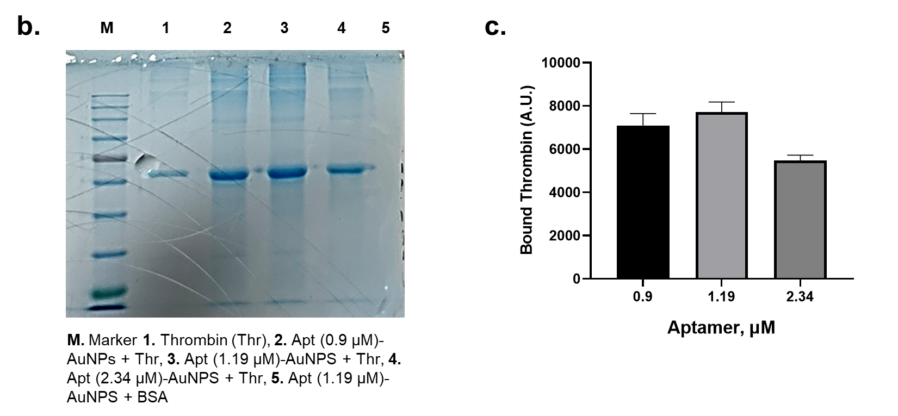
Thrombin binding on TBA1-AuNPs
Thrombin binding on TBA1-AuNPs (AuFe08) is verified by electrophoretic analyses (agarose and polyacrylamide gel)
These results are currently replicated with core-shell MNPs (AuFe11-GMCP3)

Slide 17
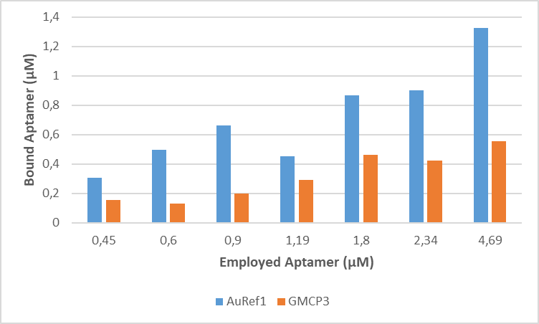
Reproducibility issues with Core-Shell
Fresh NPs
2 months later
Binding of TBA1 on AuNPs (AuRef1) was similar, but at core-shell (AuFe11-GMCP3) binding efficiency was lower

Slide 18
Progress for each AuNPs synthesis
Nanoparticles | Code Name | Aptamers studied | Results/comments
Phytic Acid MNPs | AuFe01 Au-decorated MNPS - GMCP1 | ΤΒΑ1 (Thrombin) | Issues with aggregation Binding of aptamer not verified | Study could be repeated with the newest FAM-modified aptamers and more stable nanoparticles
Core shell AuMNPs | AuFe05 GMCP2 | TBA1 (Thrombin) | Issues with aggregation Binding of aptamer not verified | Study could be repeated with the newest FAM-modified aptamers and more stable nanoparticles
Core Shell AuMNPs | AuFe11 GMCP3 | TBA1 (Thrombin) RNV95 aptamer (Αβ40) Αβ7-92 aptamer (Αβ42) | Conjugation of all aptamers verified with fluorometry Issues with stability after 2 months (initially better binding than Au, but not replicated) | Study will be repeated after provision of fresh suspension Binding of peptides pending
Core Shell AuMNPs | AuFe15 GMCP4 | TBA1 (Thrombin) | Provided in dry form. Could not be resuspended | Study will be repeated after provision of fresh suspension
AuNPs | AuFe07 Au Reference-1 Au-ref AuFe08 Au Reference-2 GMCP4-Au Part | TBA1 (Thrombin) RNV95 aptamer (Αβ40) Αβ7-92 aptamer (Αβ42) | Conjugation of all aptamers verified with fluorometry Binding of Thrombin verified | Binding of amyloid peptides pending

